Slide 1


Slide 2
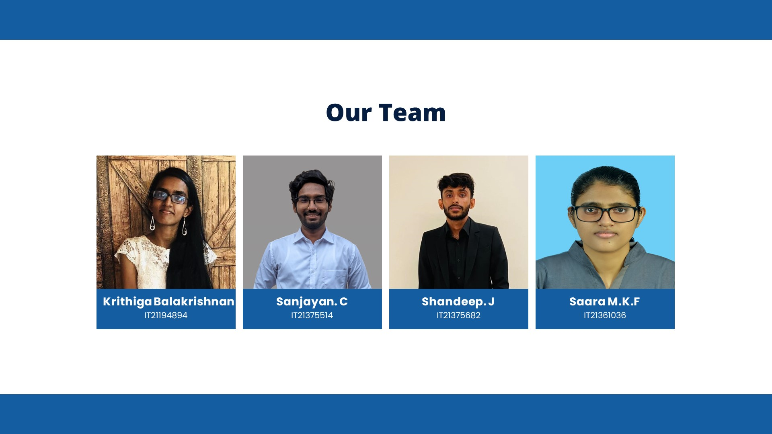

Slide 3
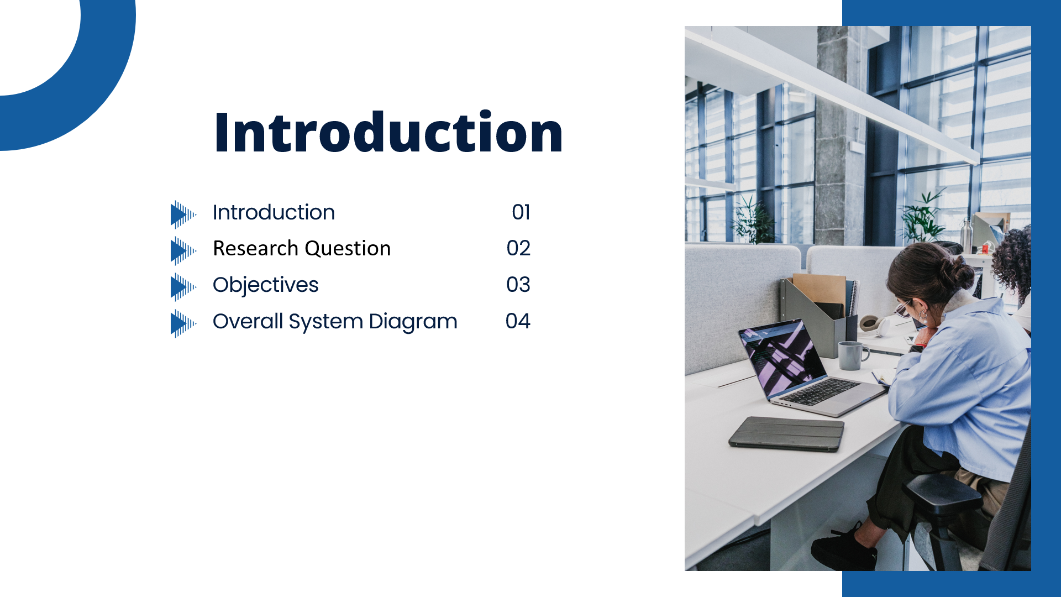

Slide 4
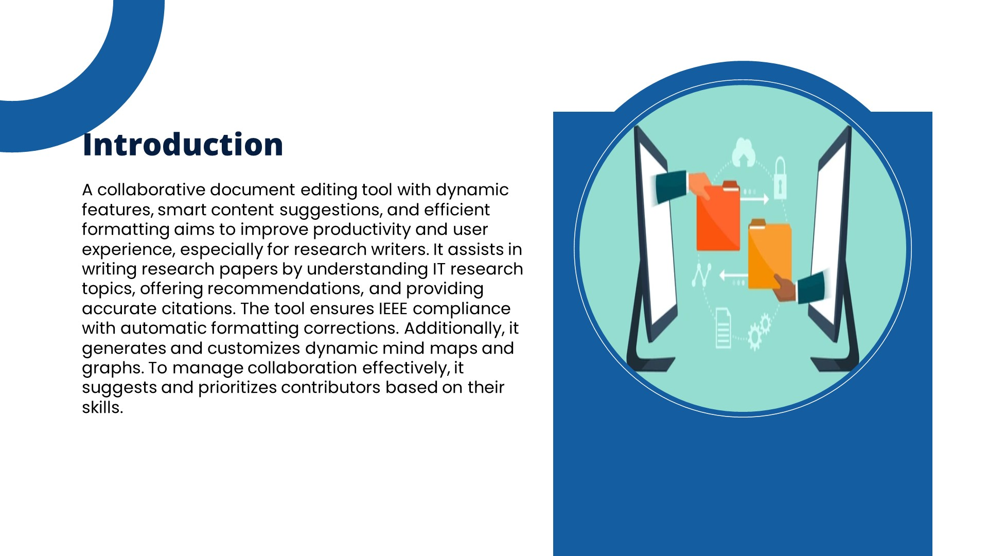

Slide 5
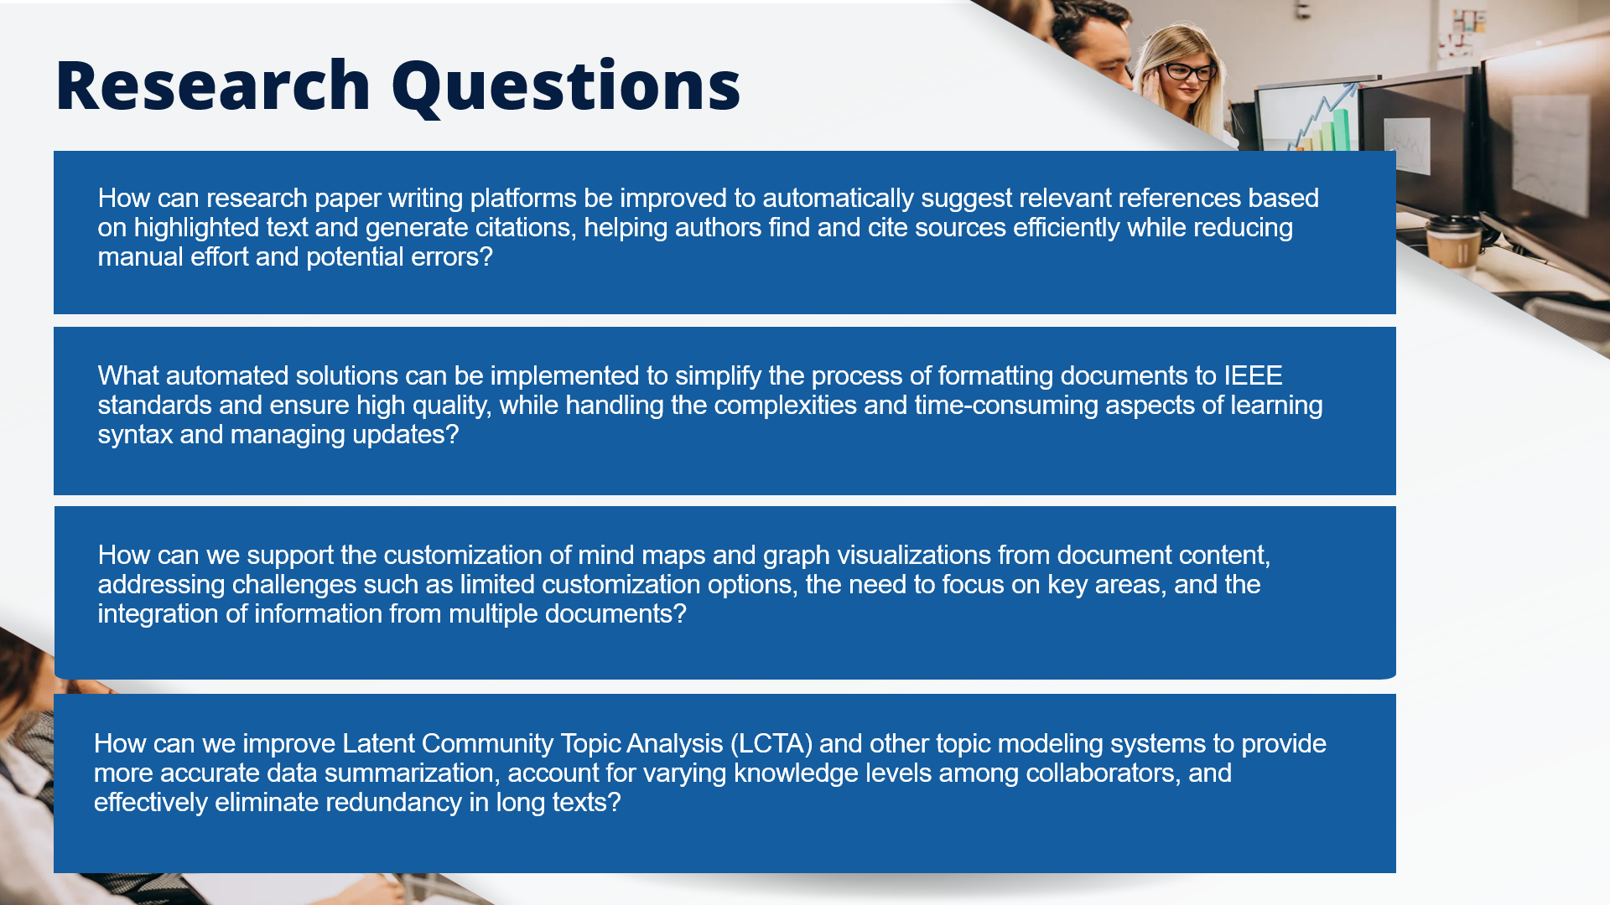

Slide 6
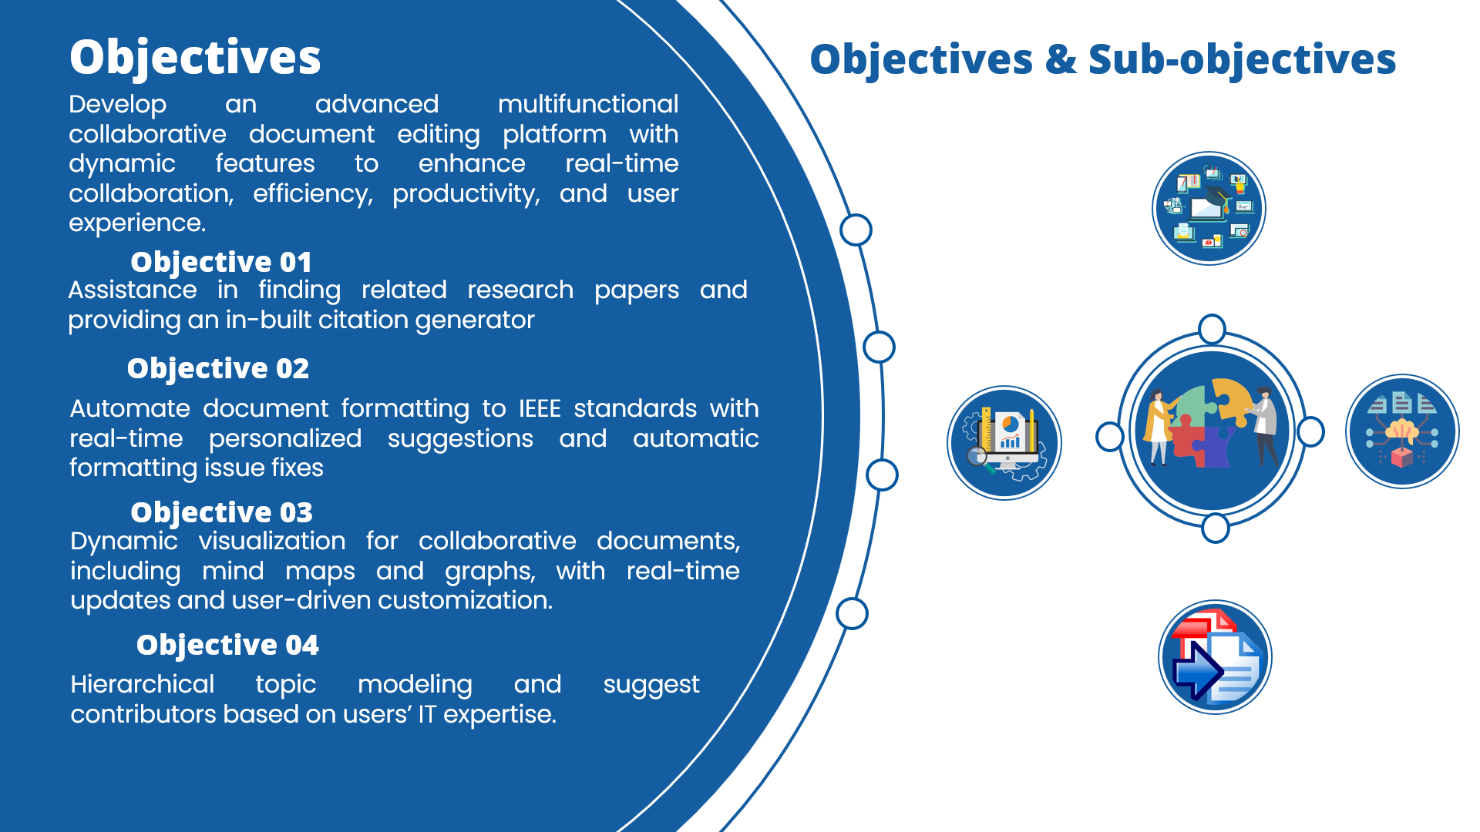

Slide 7
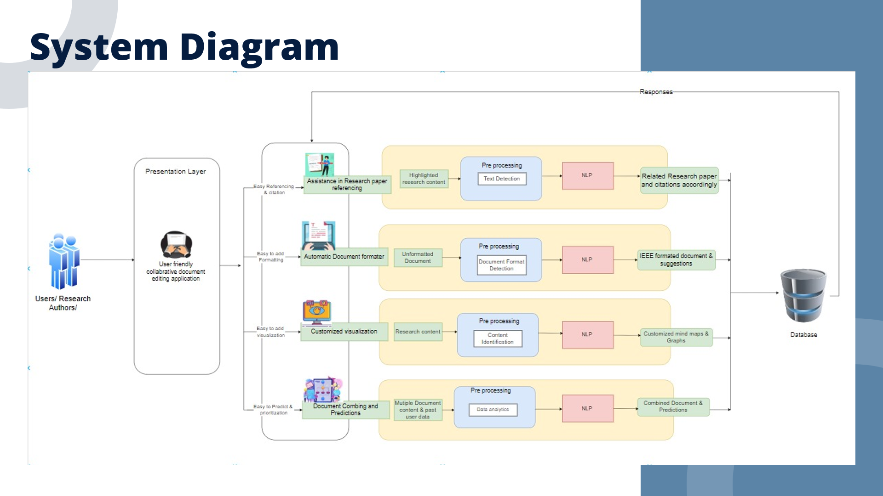

Slide 8
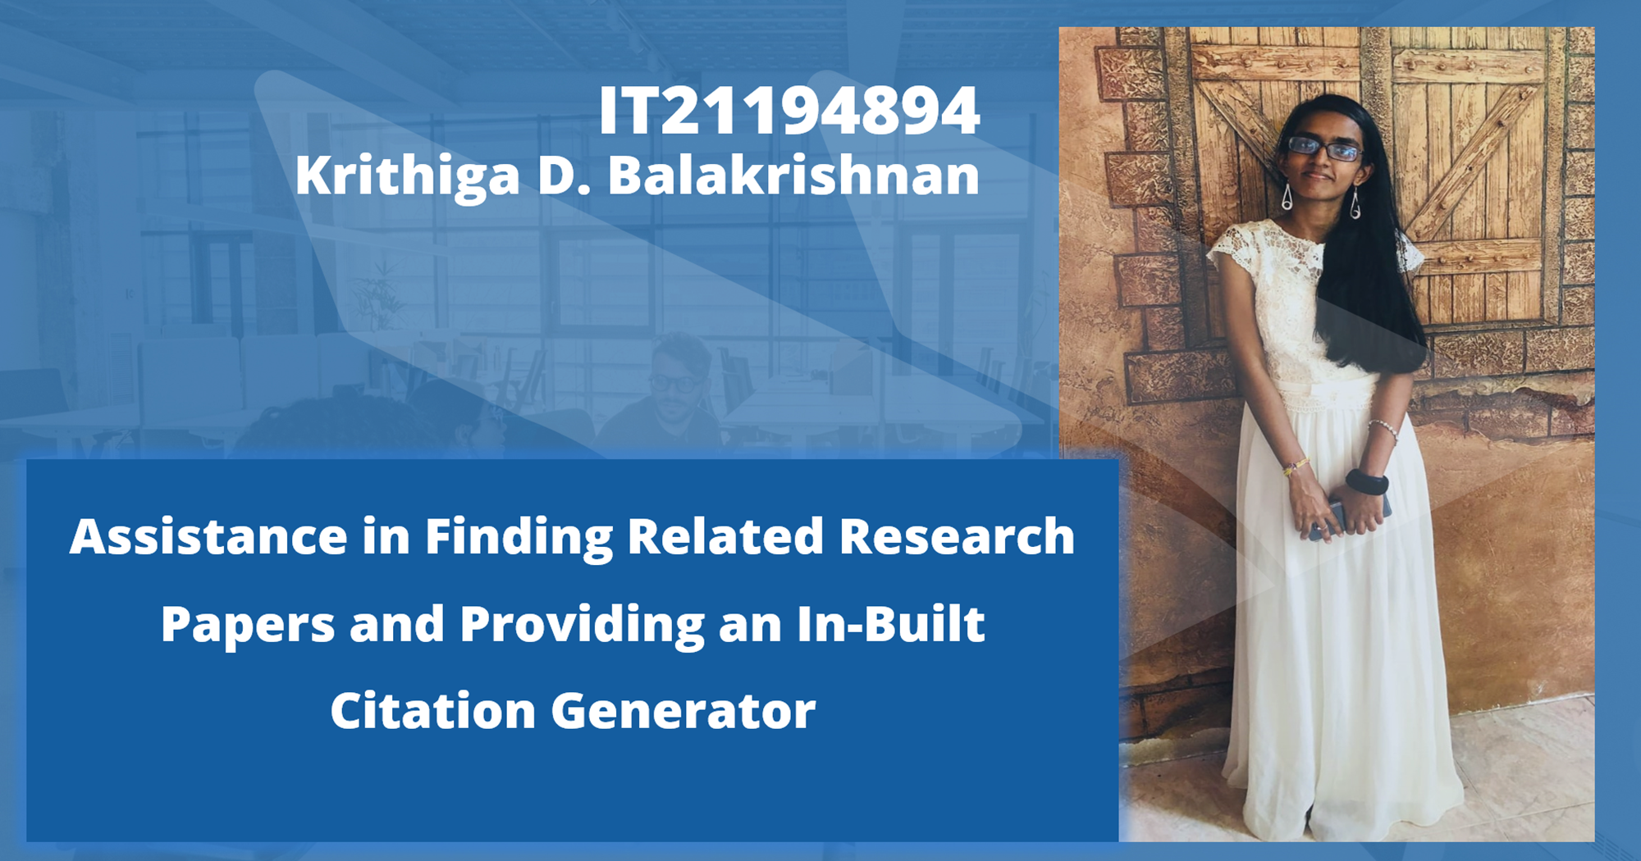
IT21194894 | Krithiga. D. Balakrishnan | 24-25J-146

Slide 9

IT21194894 | Krithiga. D. Balakrishnan | 24-25J-146

Slide 10
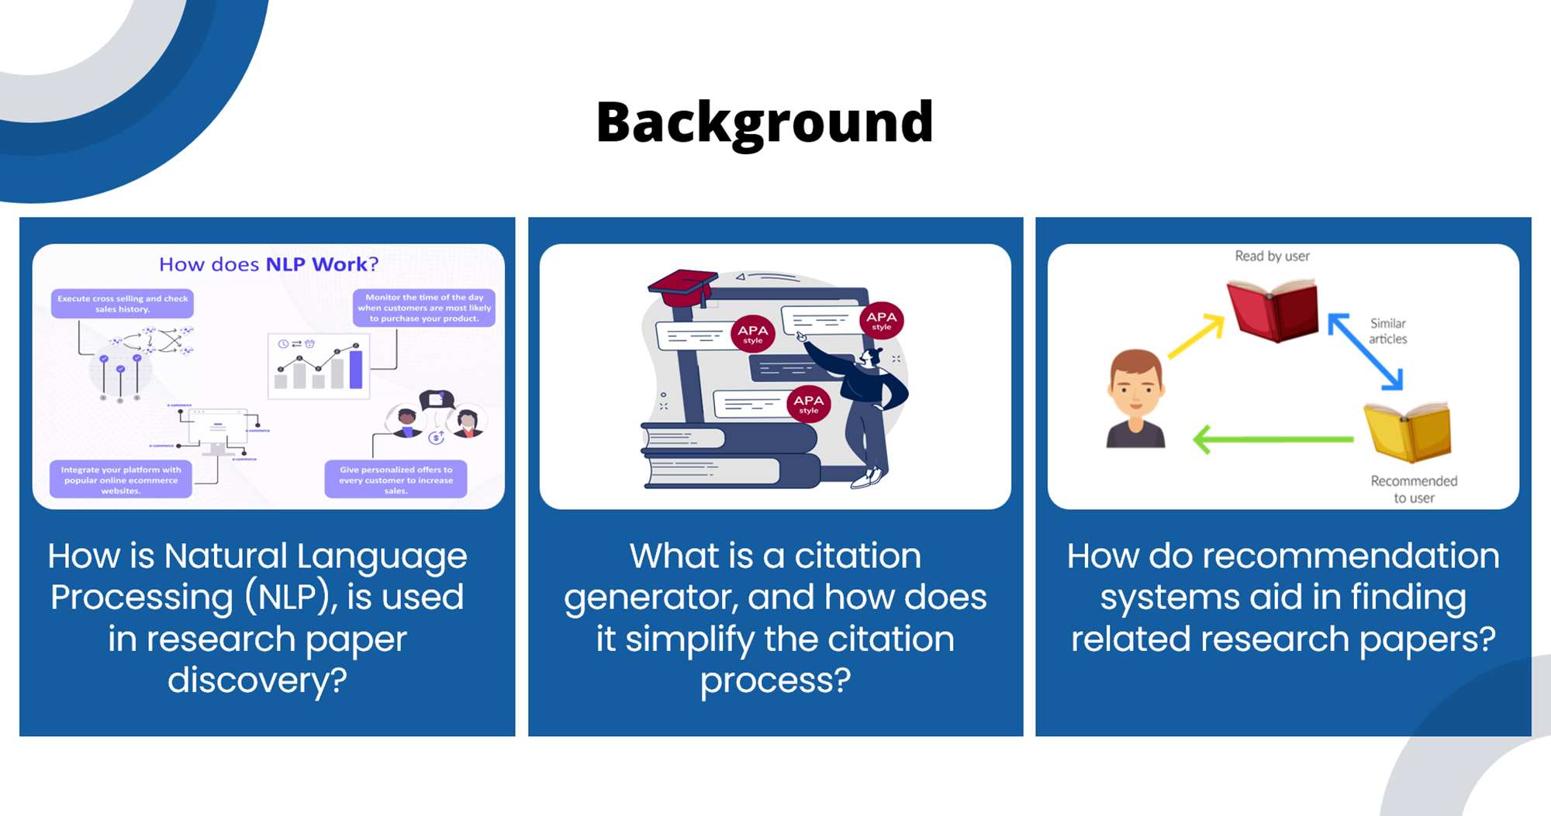
IT21194894 | Krithiga. D. Balakrishnan | 24-25J-146

Slide 11
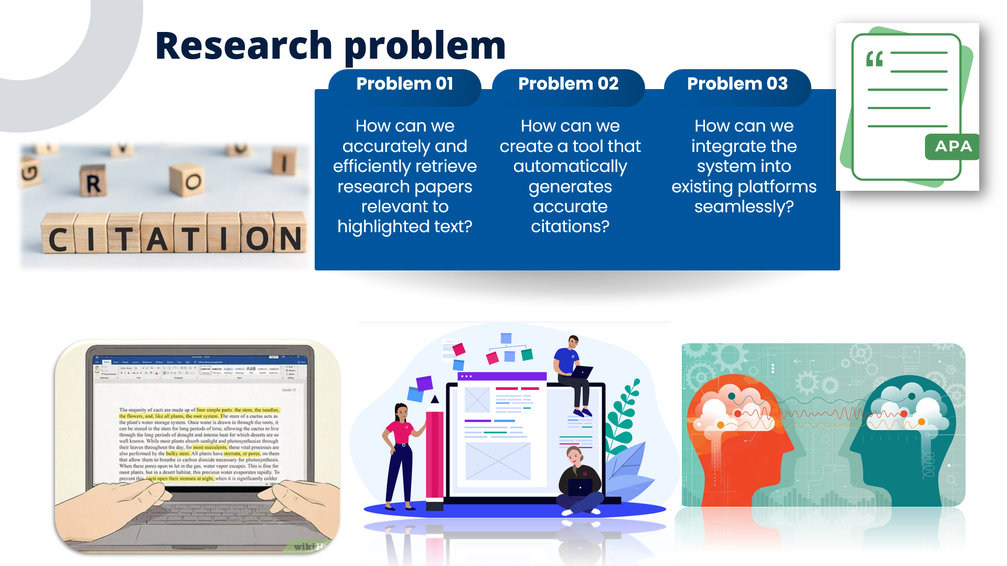
IT21194894 | Krithiga. D. Balakrishnan | 24-25J-146

Slide 12
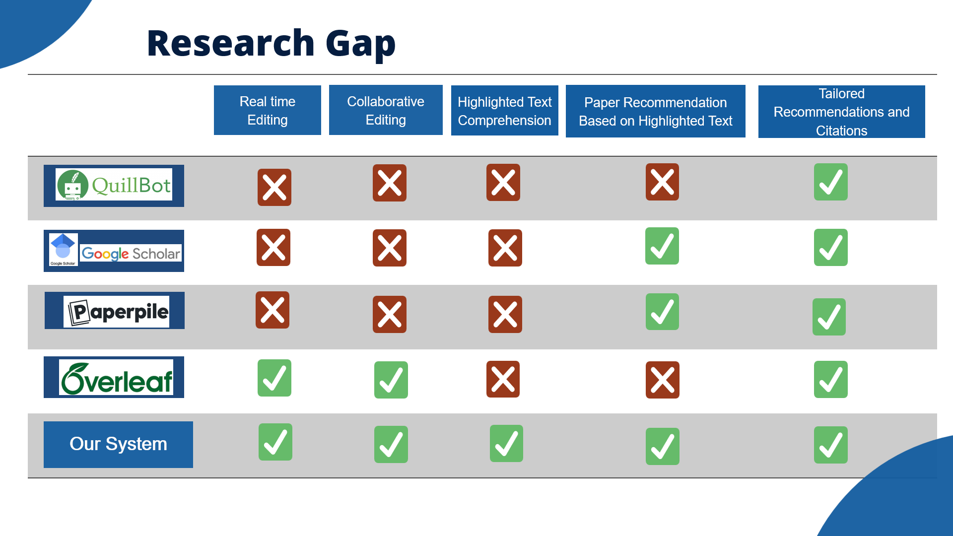
IT21194894 | Krithiga. D. Balakrishnan | 24-25J-146

Slide 13
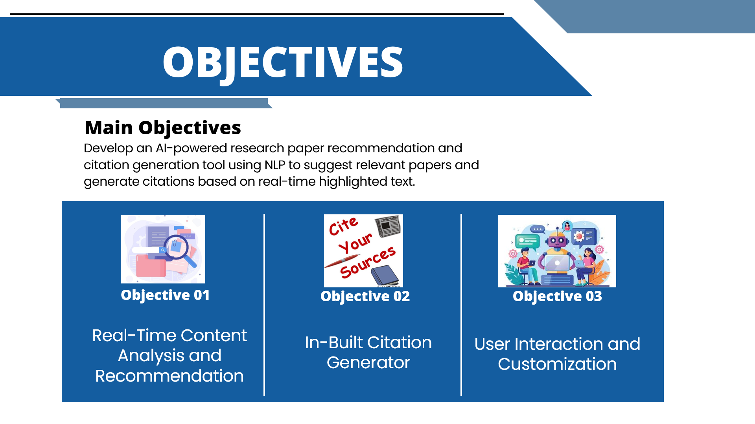
IT21194894 | Krithiga. D. Balakrishnan | 24-25J-146

Slide 14
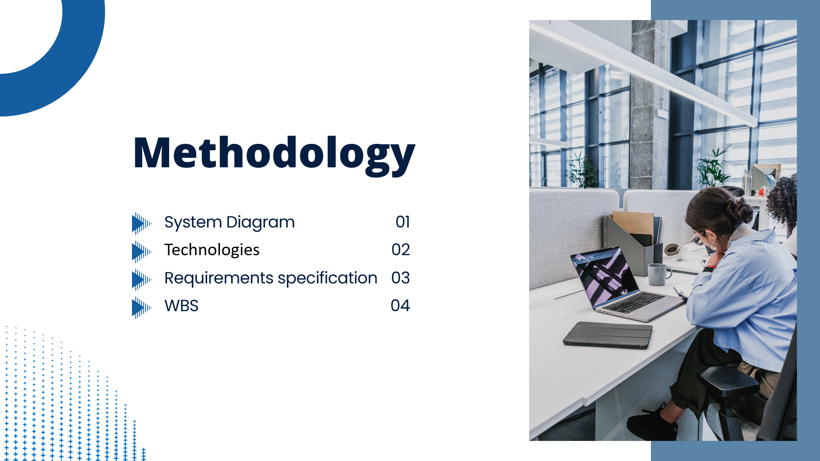
IT21194894 | Krithiga. D. Balakrishnan | 24-25J-146

Slide 15
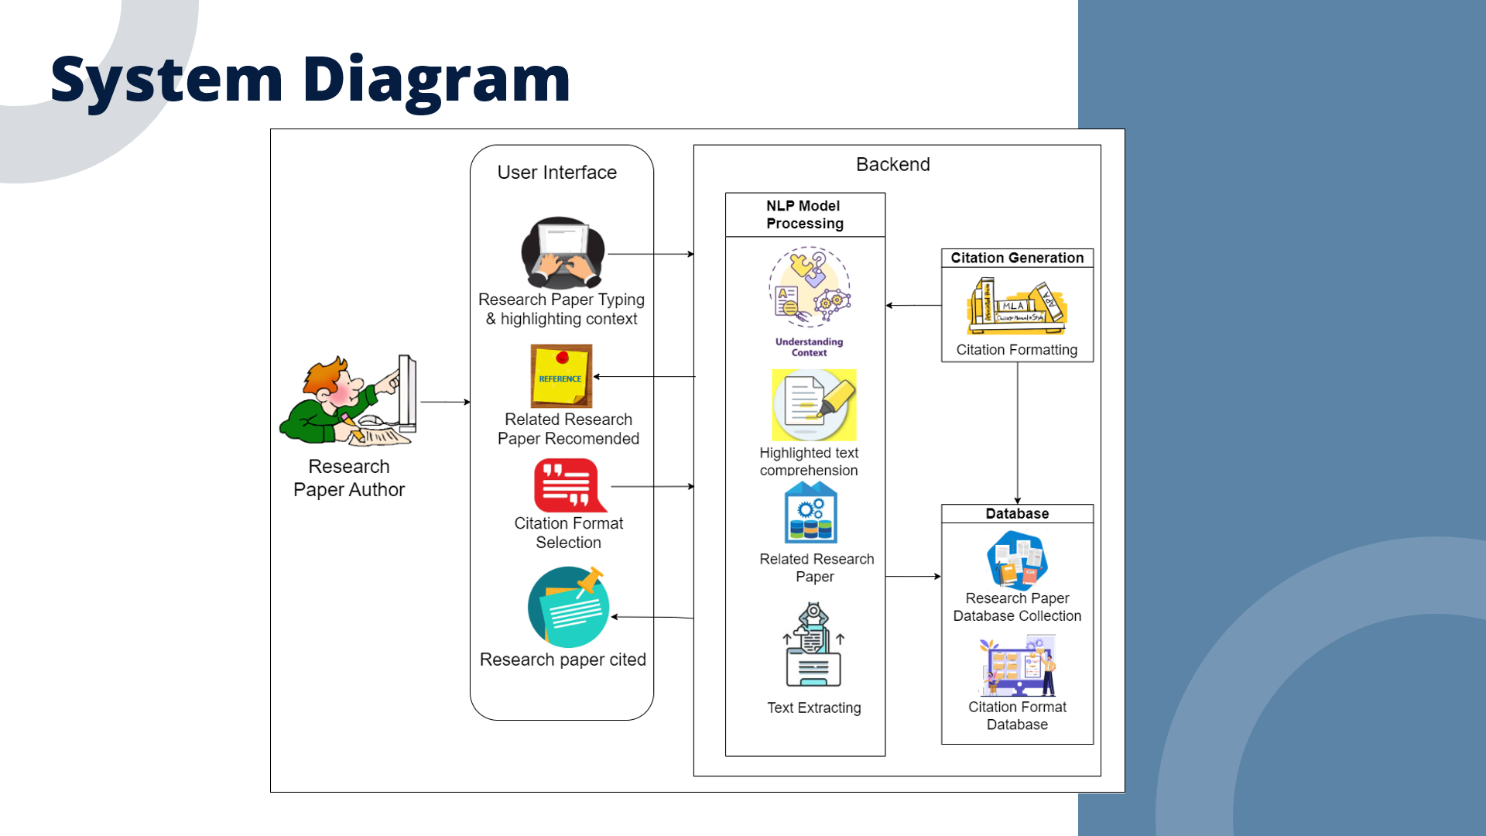
IT21194894 | Krithiga. D. Balakrishnan | 24-25J-146

Slide 16
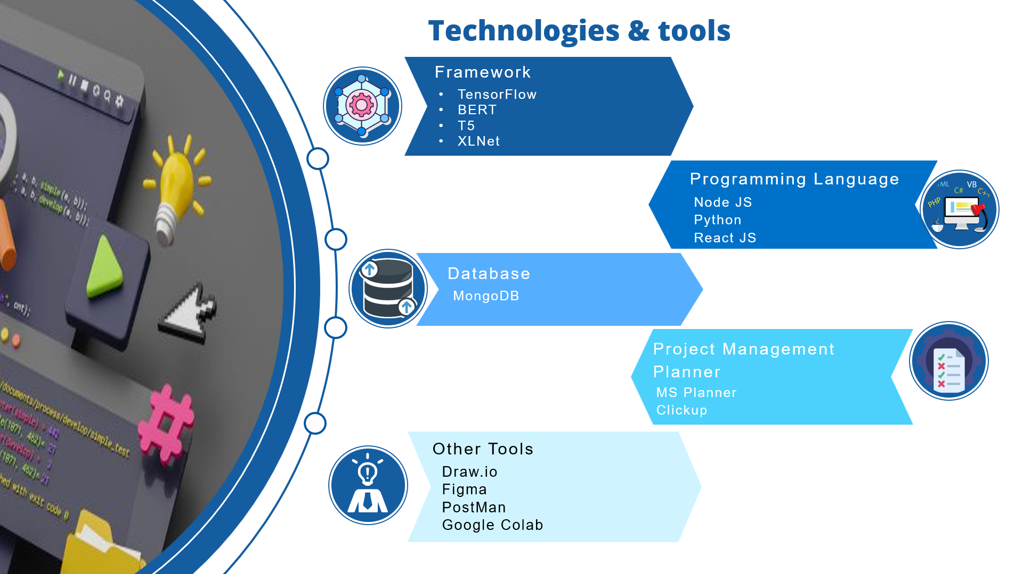
IT21194894 | Krithiga. D. Balakrishnan | 24-25J-146

Slide 17
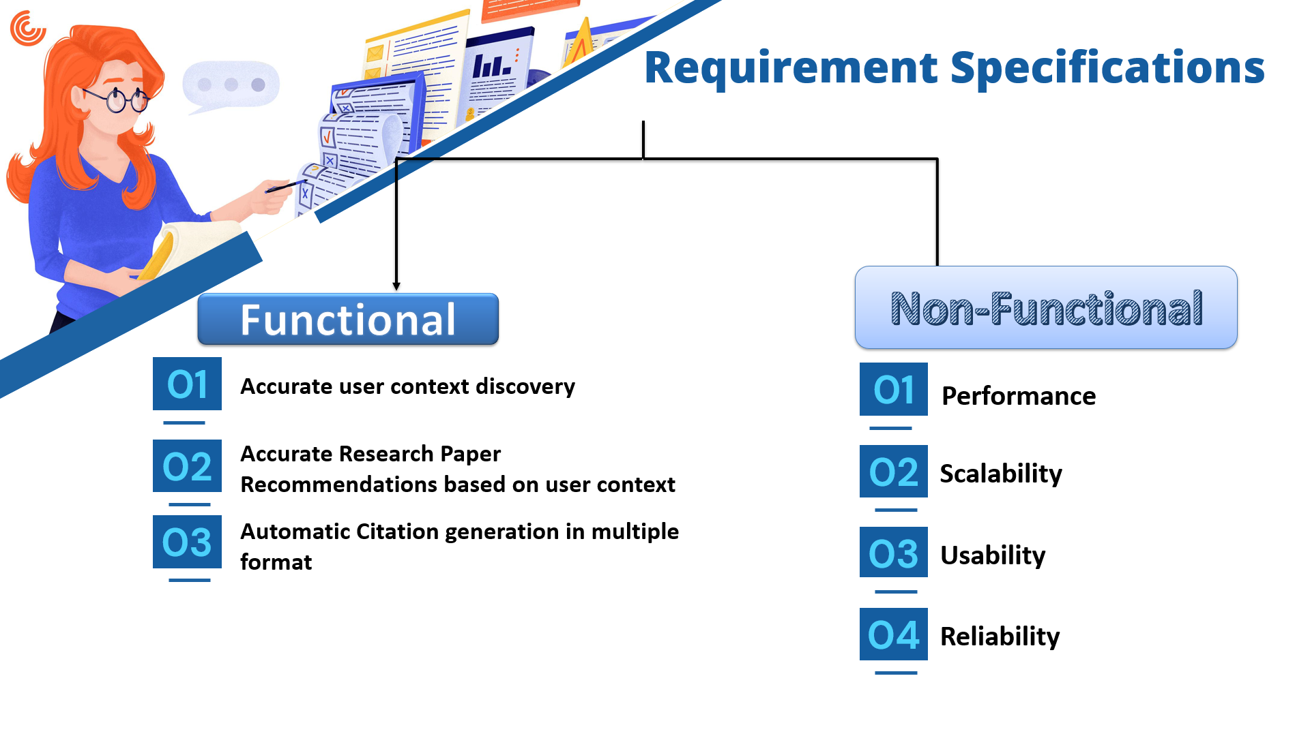
IT21194894 | Krithiga. D. Balakrishnan | 24-25J-146

Slide 18
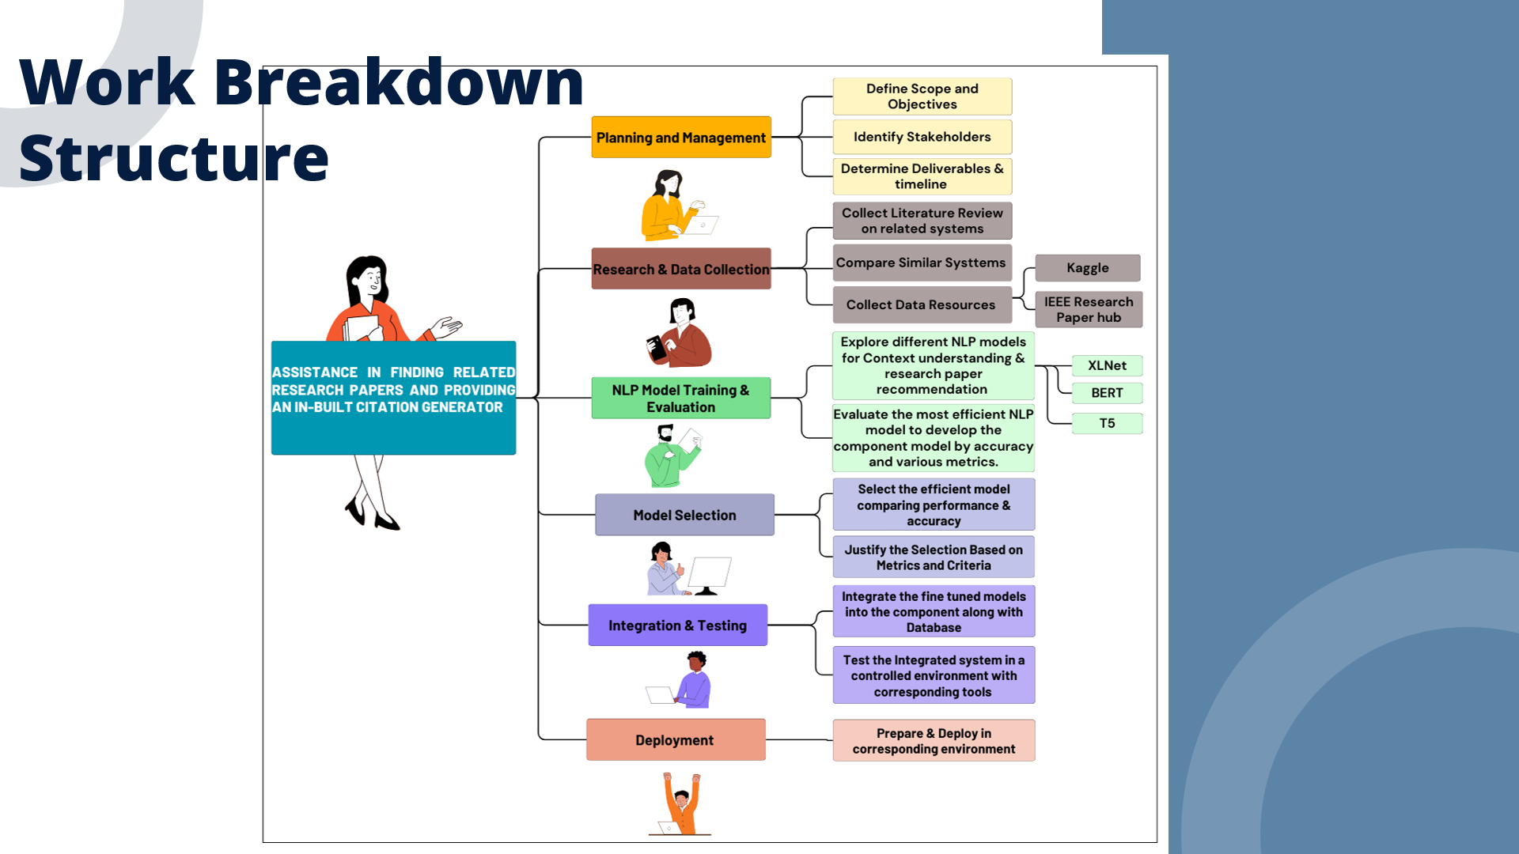
IT21194894 | Krithiga. D. Balakrishnan | 24-25J-146

Slide 19
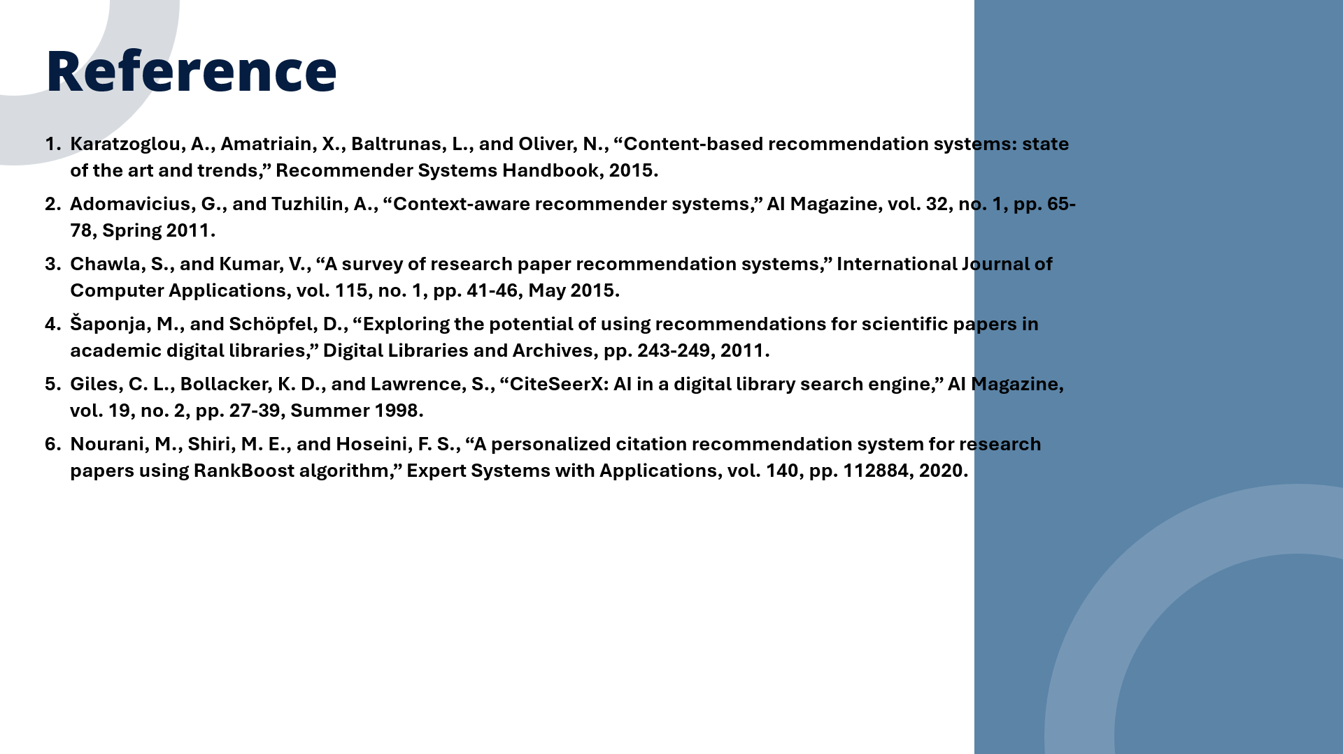
IT21194894 | Krithiga. D. Balakrishnan | 24-25J-146

Slide 20
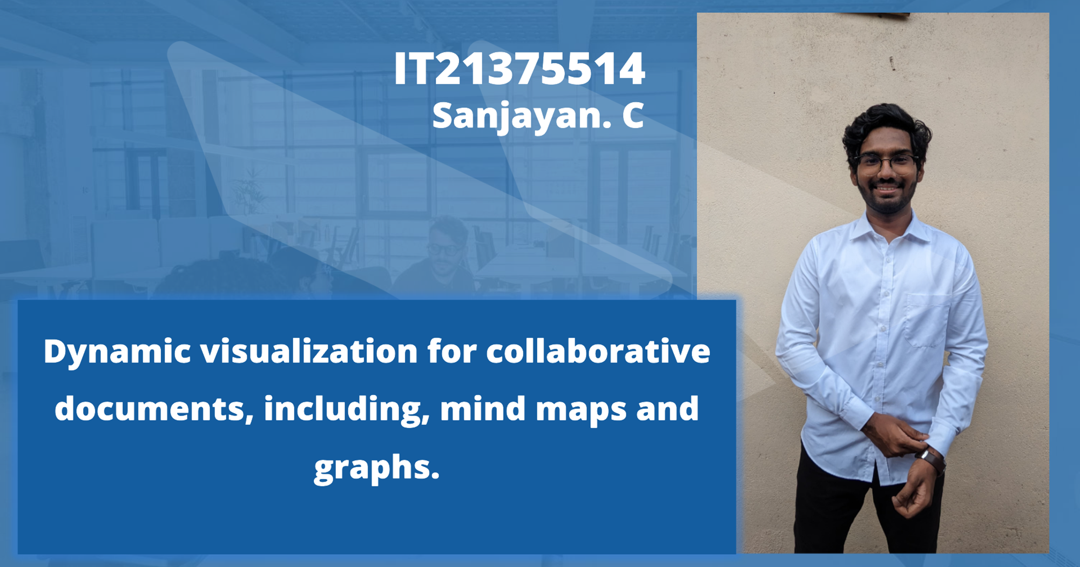
IT21375514 | Sanjayan. C | 24-25J-146

Slide 21
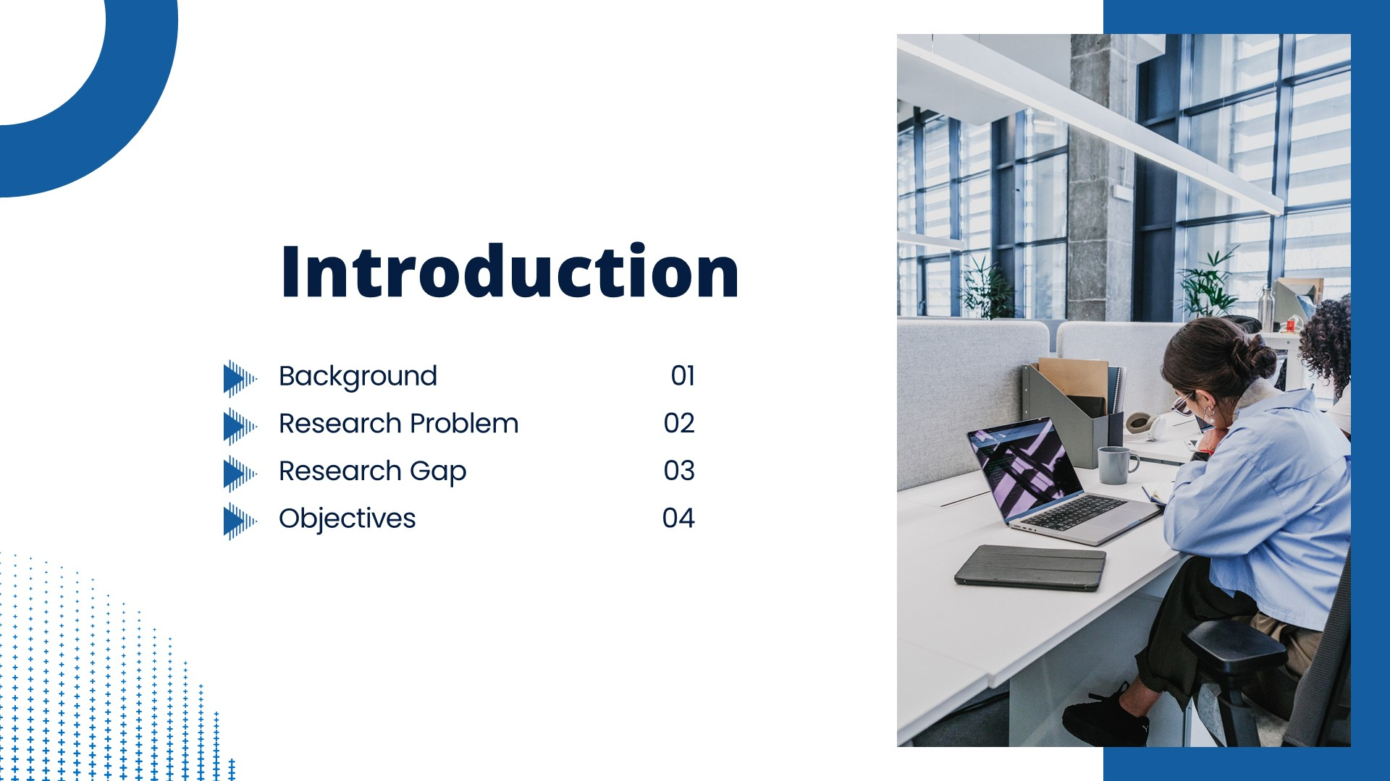
IT21375514 | Sanjayan. C | 24-25J-146

Slide 22

IT21375514 | Sanjayan. C | 24-25J-146

Slide 23
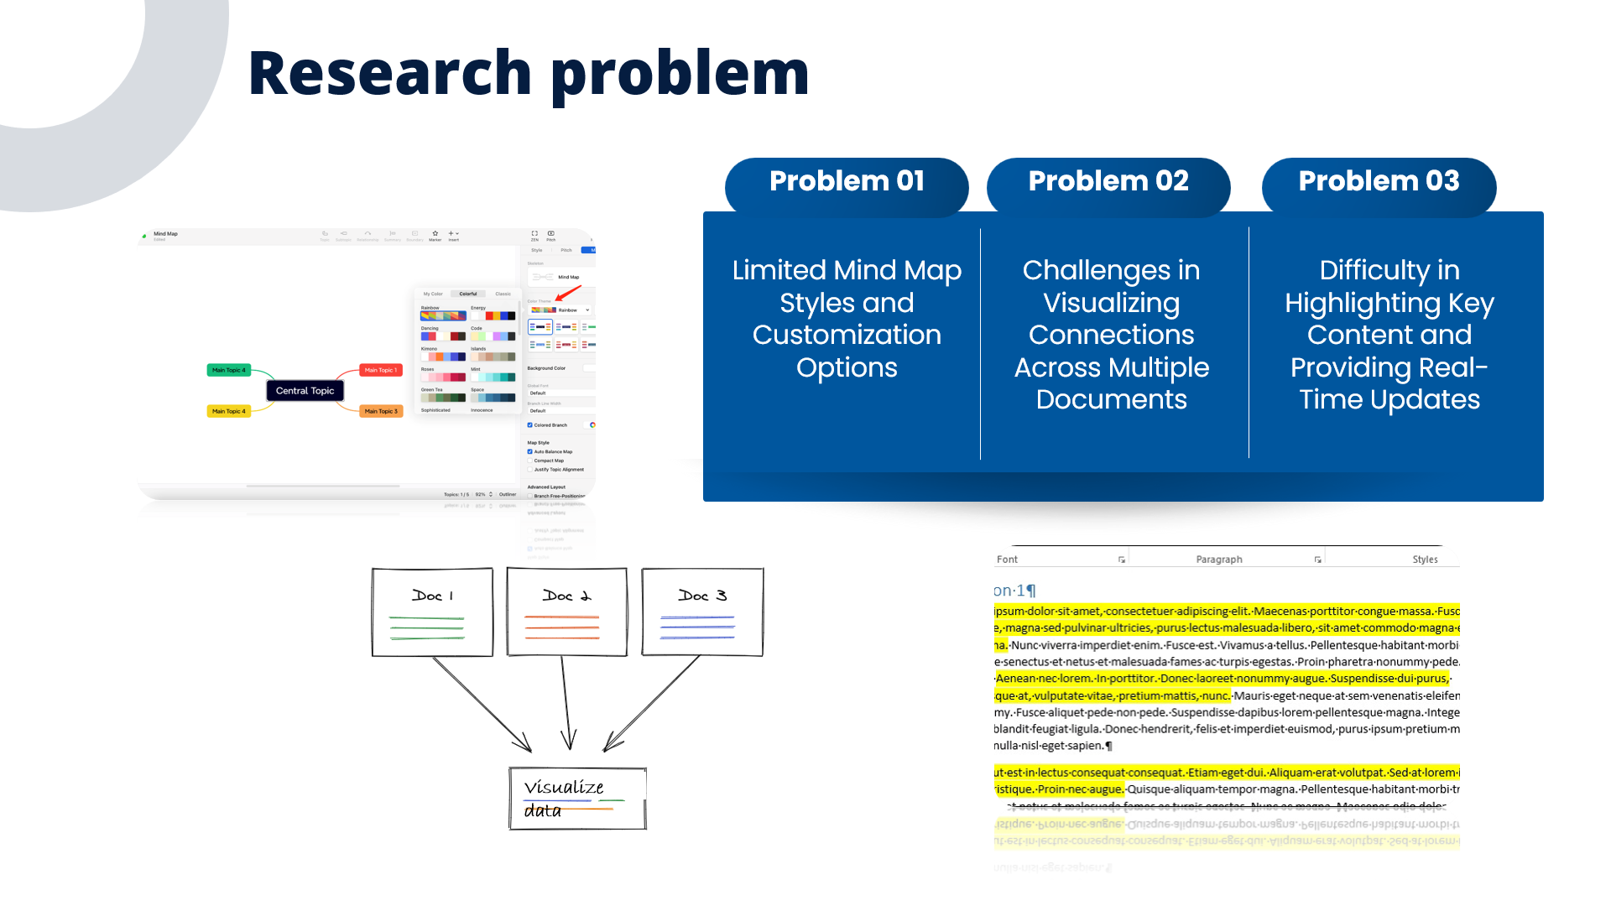
IT21375514 | Sanjayan. C | 24-25J-146

Slide 24
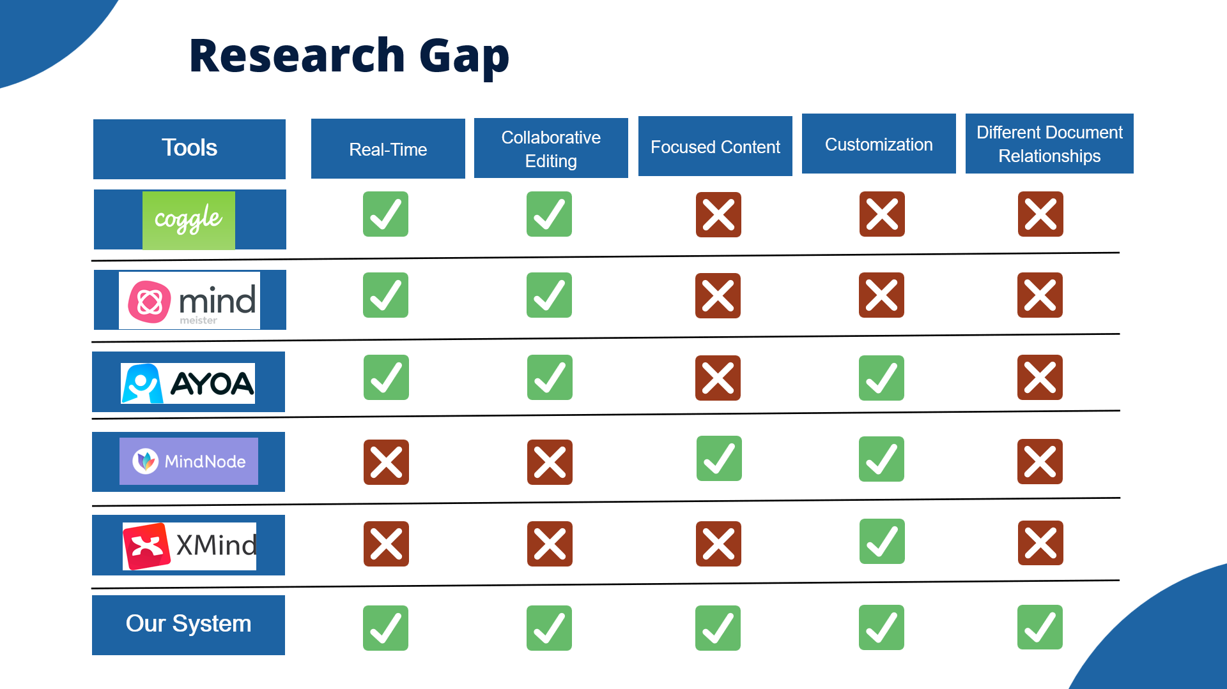
IT21375514 | Sanjayan. C | 24-25J-146

Slide 25
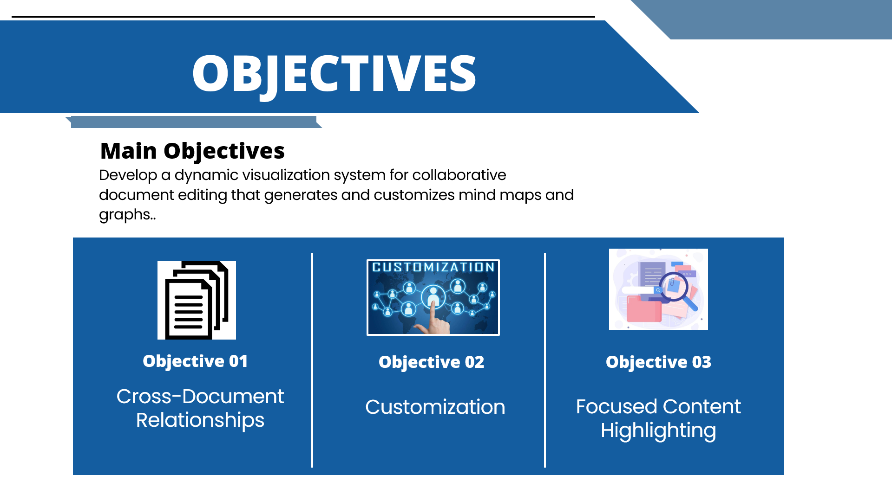
IT21375514 | Sanjayan. C | 24-25J-146

Slide 26
IT21375514 | Sanjayan. C | 24-25J-146

Slide 27
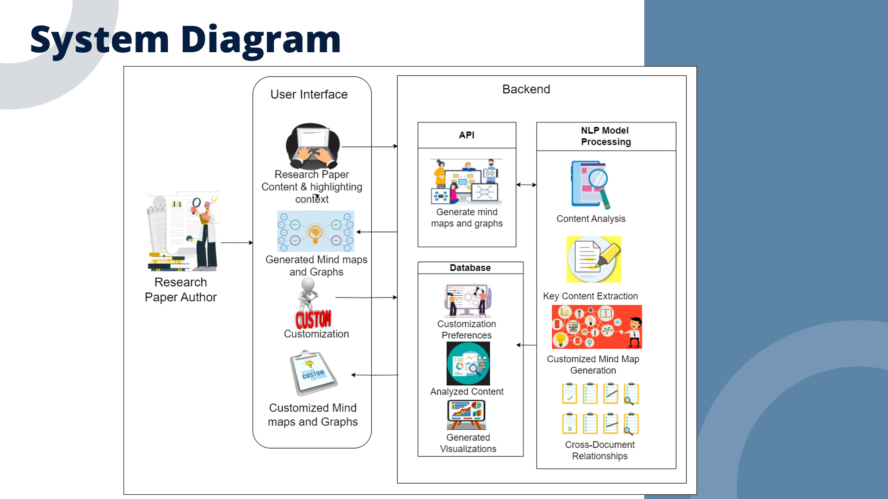
IT21375514 | Sanjayan. C | 24-25J-146

Slide 28

IT21375514 | Sanjayan. C | 24-25J-146

Slide 29
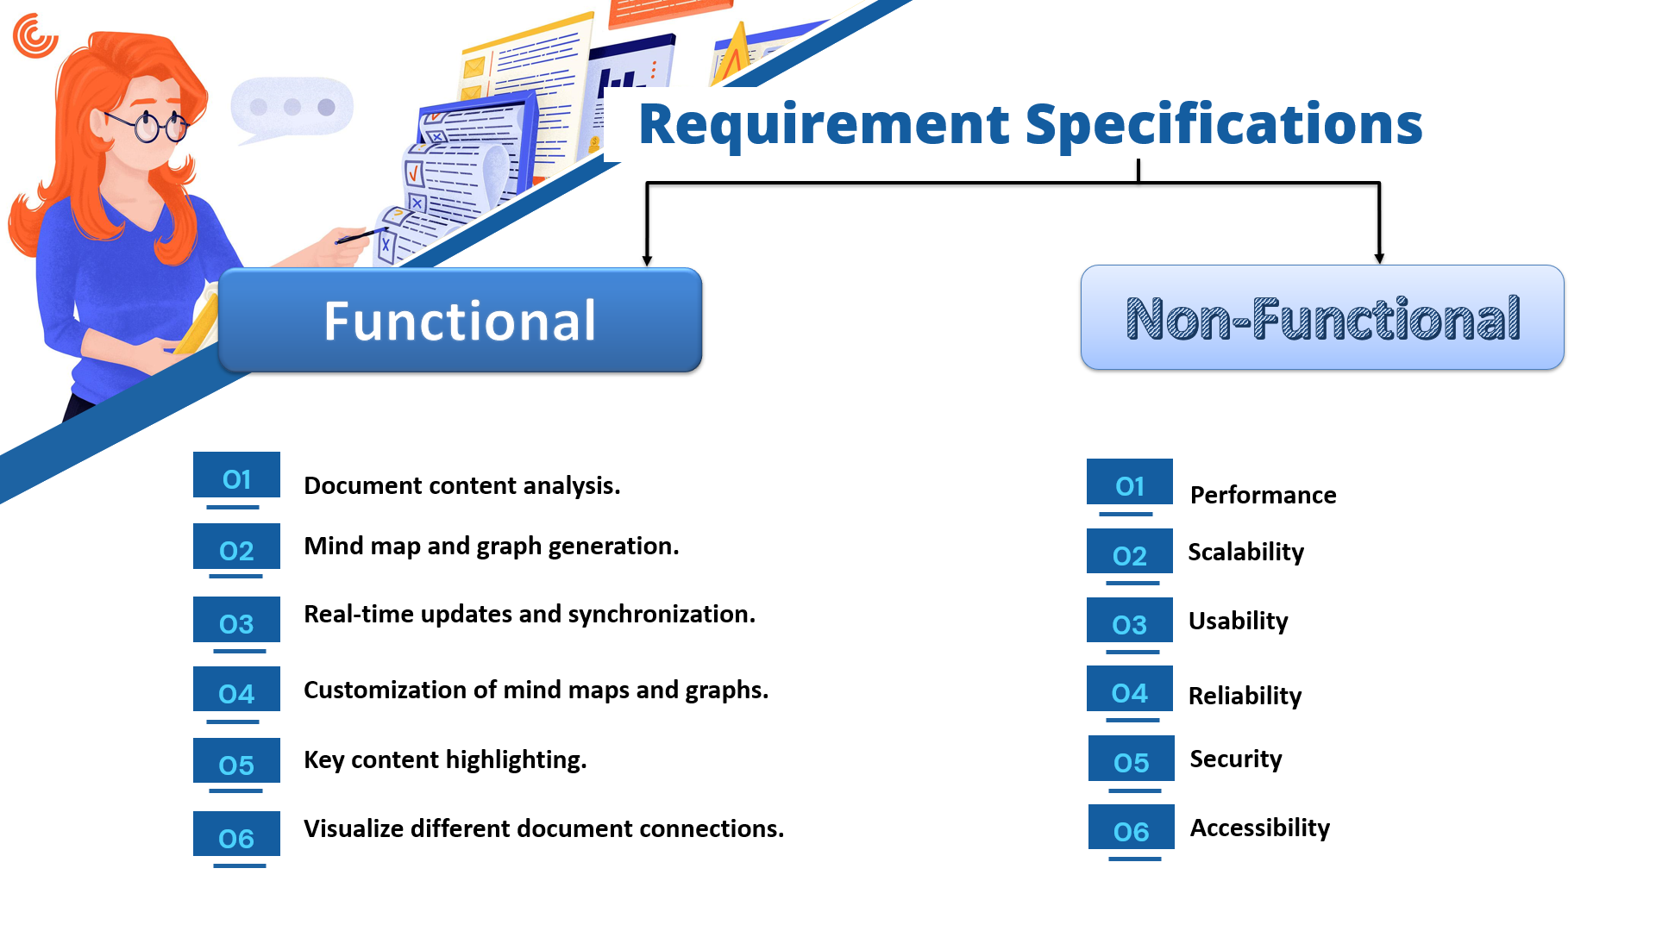
IT21375514 | Sanjayan. C | 24-25J-146

Slide 30
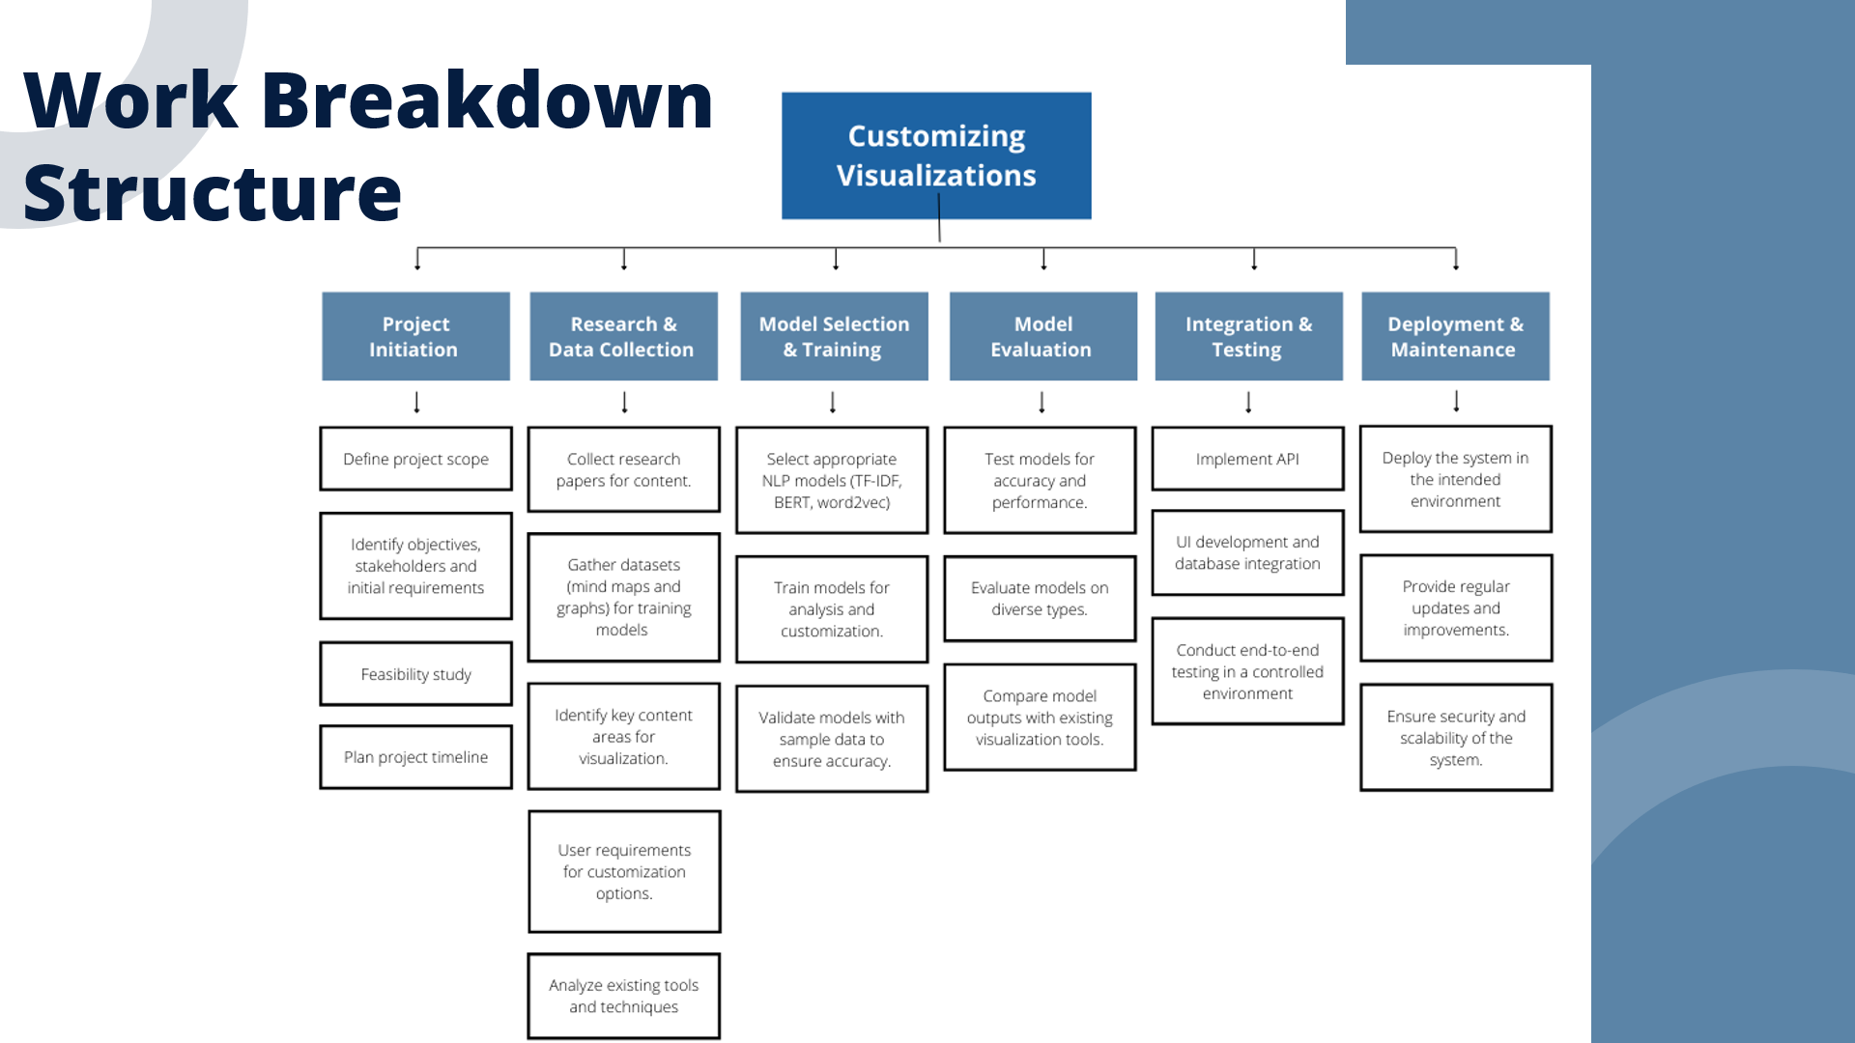
IT21375514 | Sanjayan. C | 24-25J-146

Slide 31
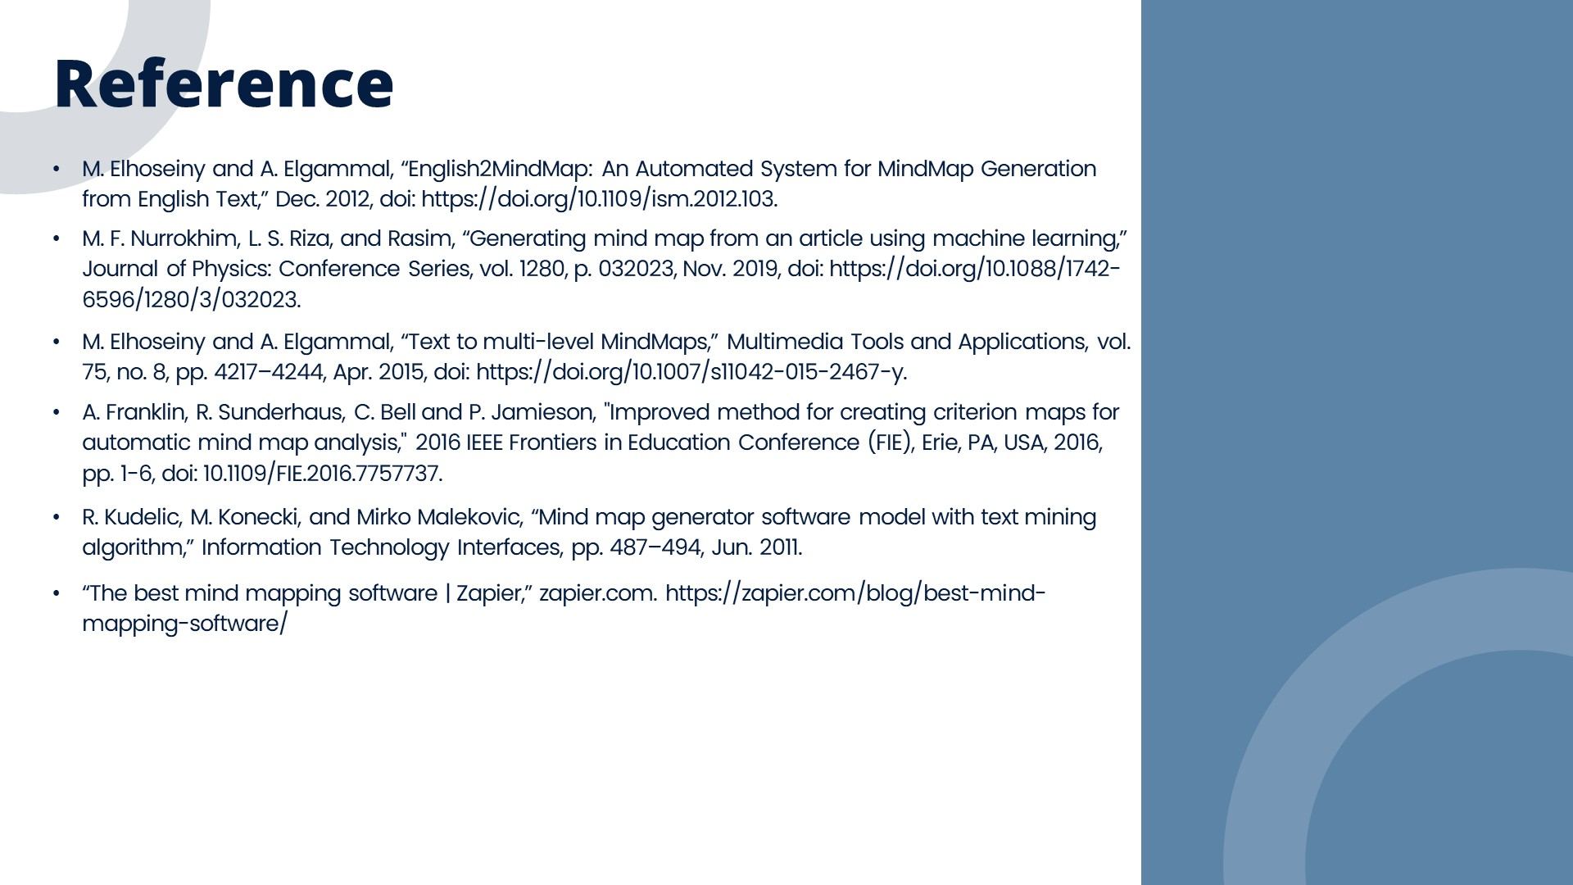
IT21375514 | Sanjayan. C | 24-25J-146

Slide 32
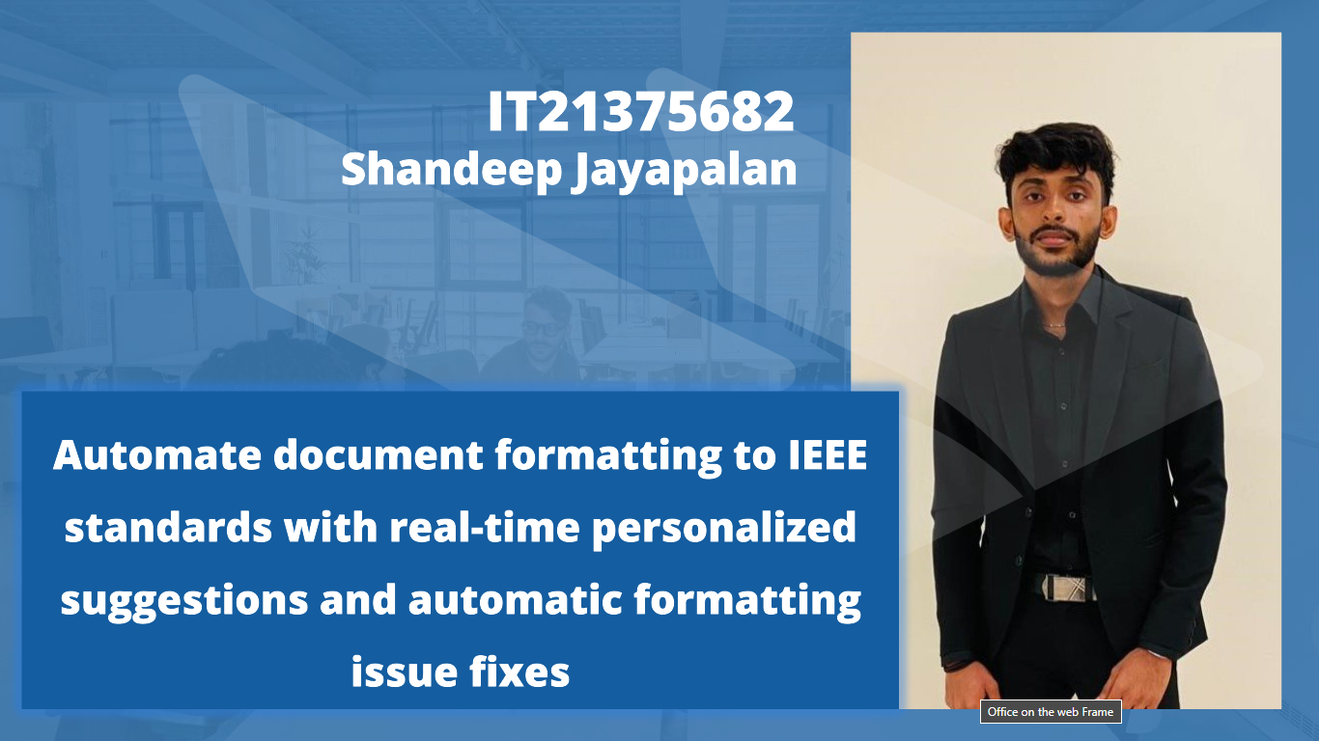
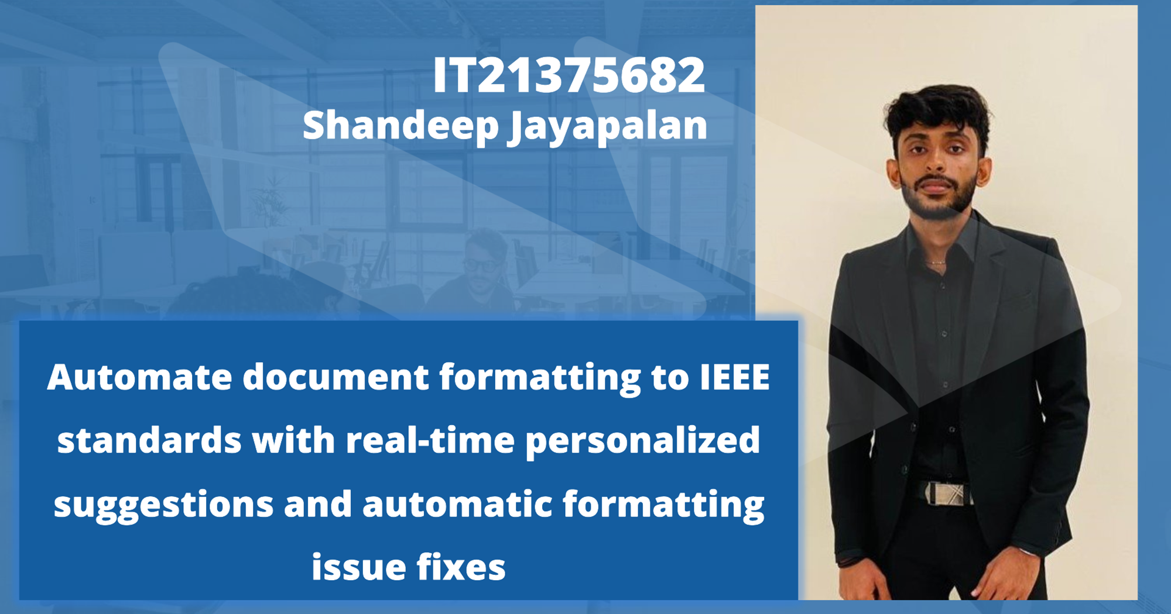
IT21375682 | Shandeep Jayapalan | 24-25J-146

Slide 33
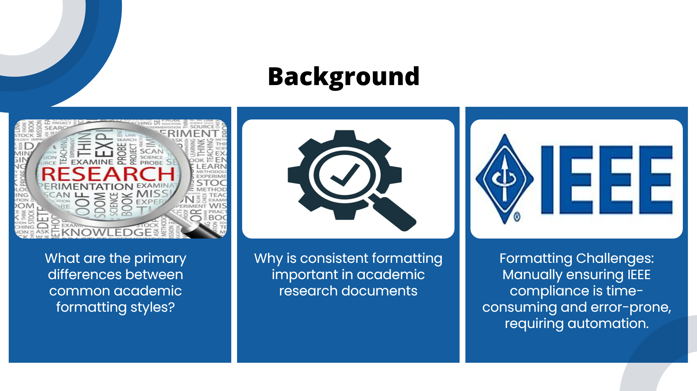
IT21375682 | Shandeep Jayapalan | 24-25J-146

Slide 34
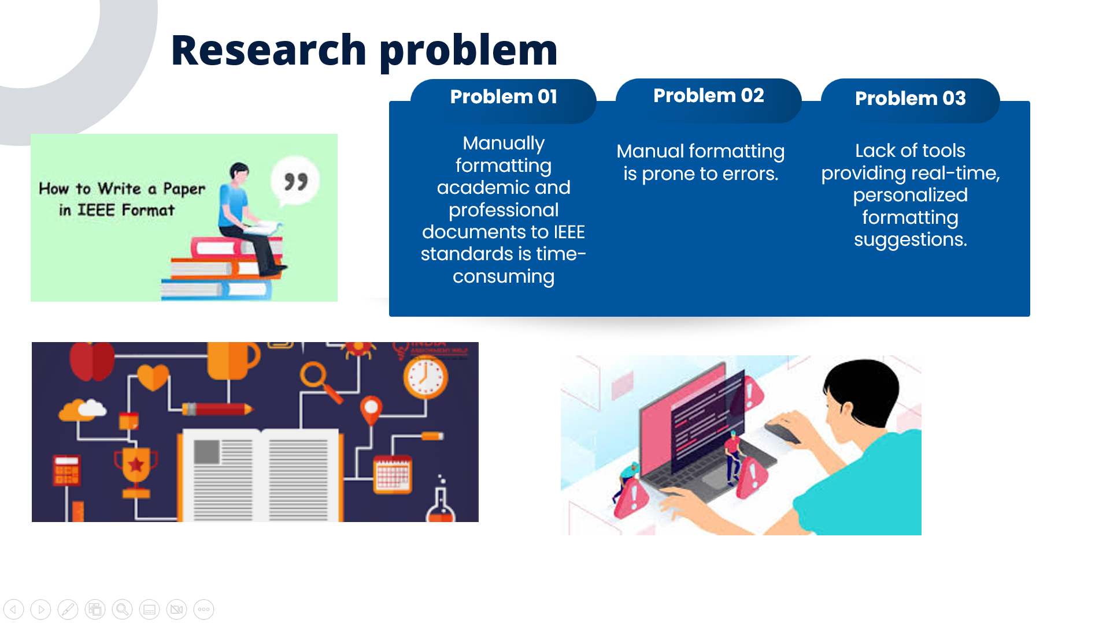
IT21375682 | Shandeep Jayapalan | 24-25J-146

Slide 35
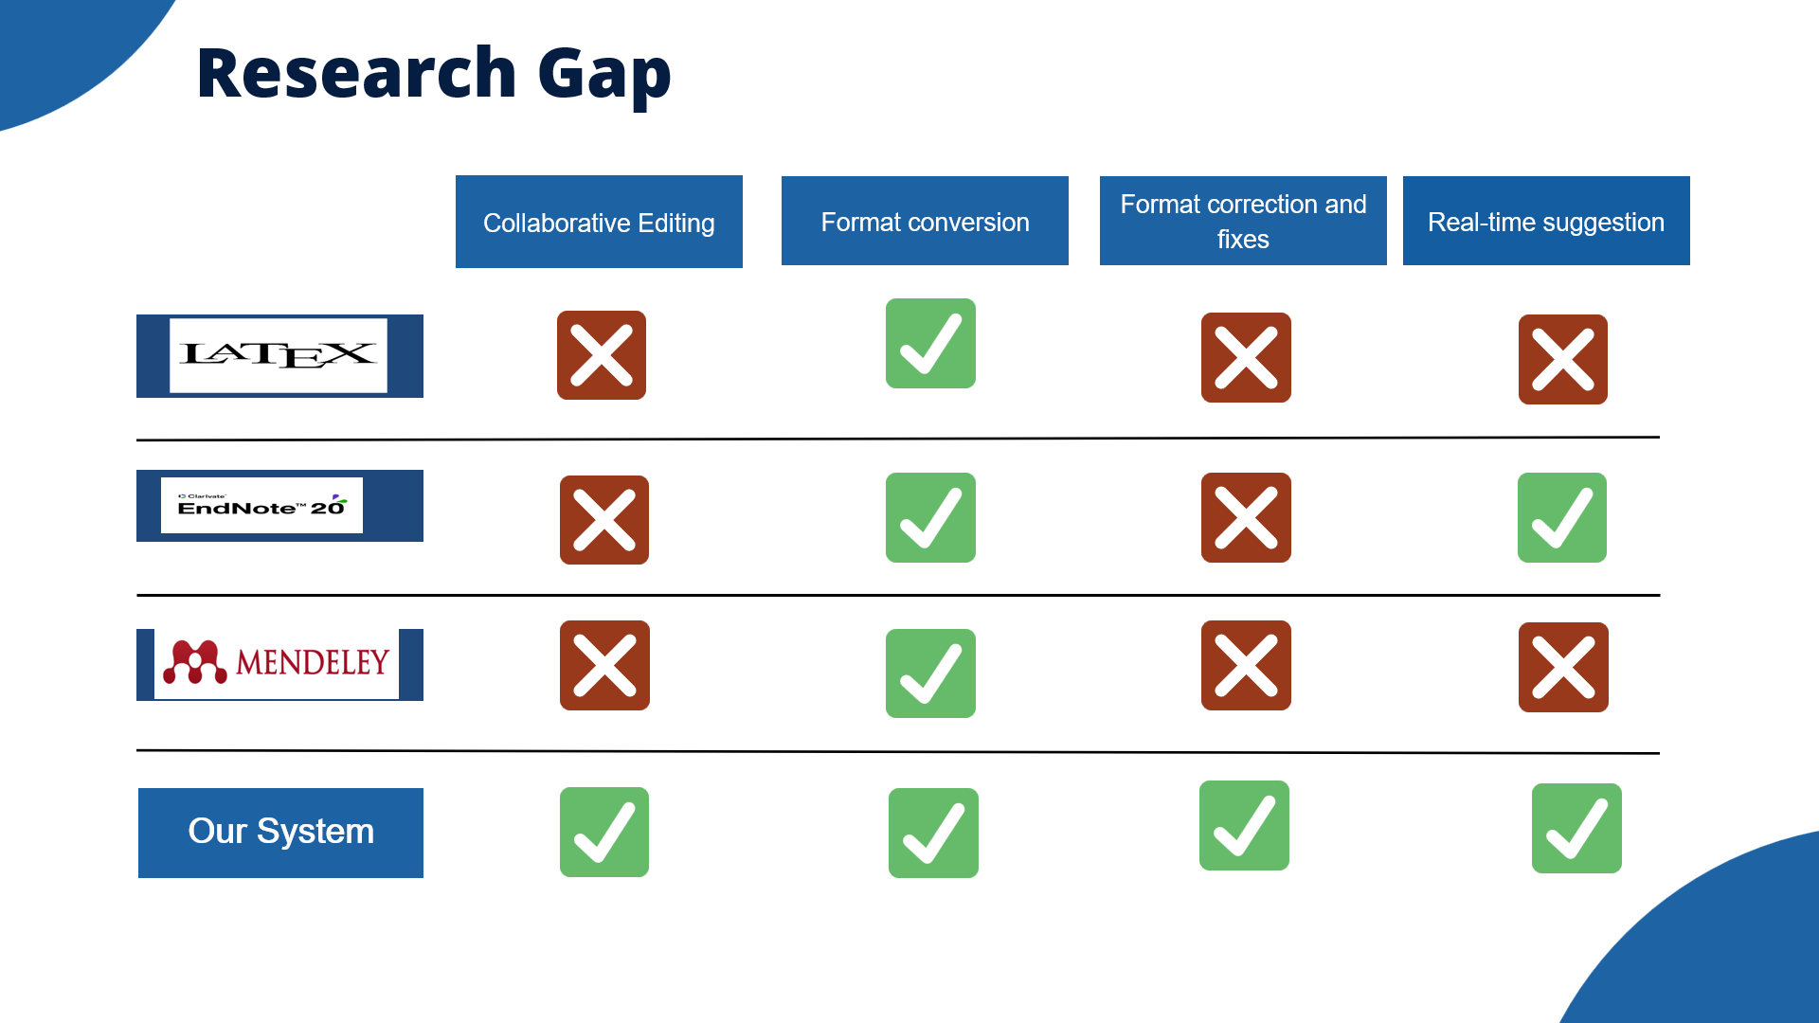
IT21375682 | Shandeep Jayapalan | 24-25J-146

Slide 36
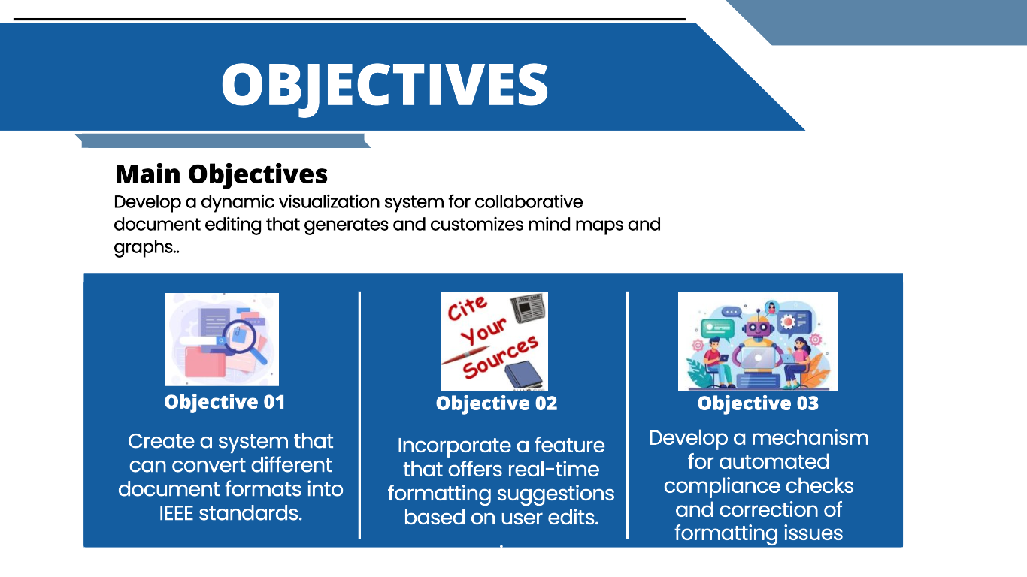
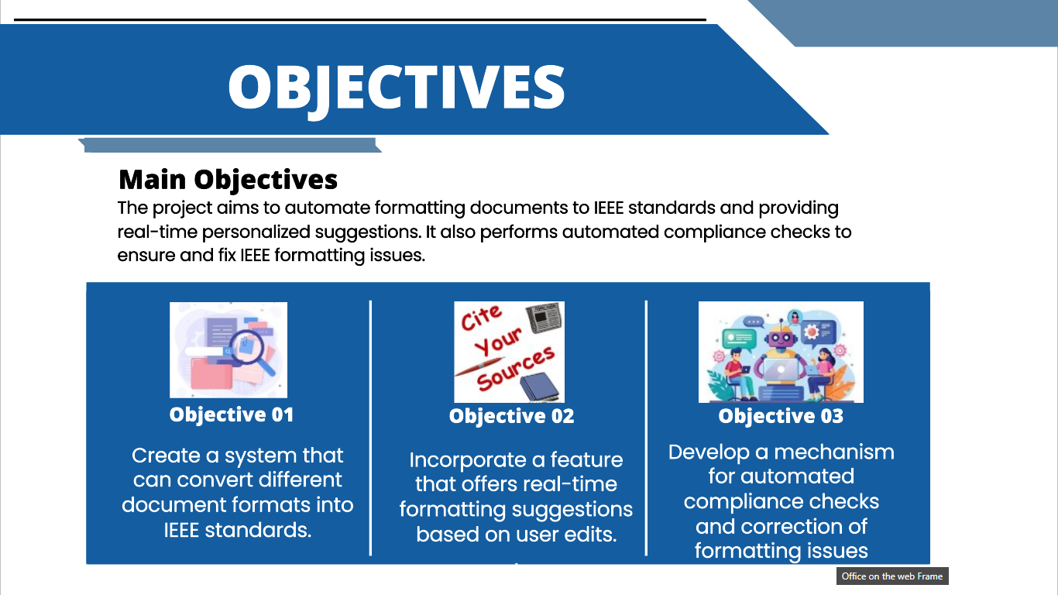
IT21375682 | Shandeep Jayapalan | 24-25J-146

Slide 37
IT21375682 | Shandeep Jayapalan | 24-25J-146

Slide 38
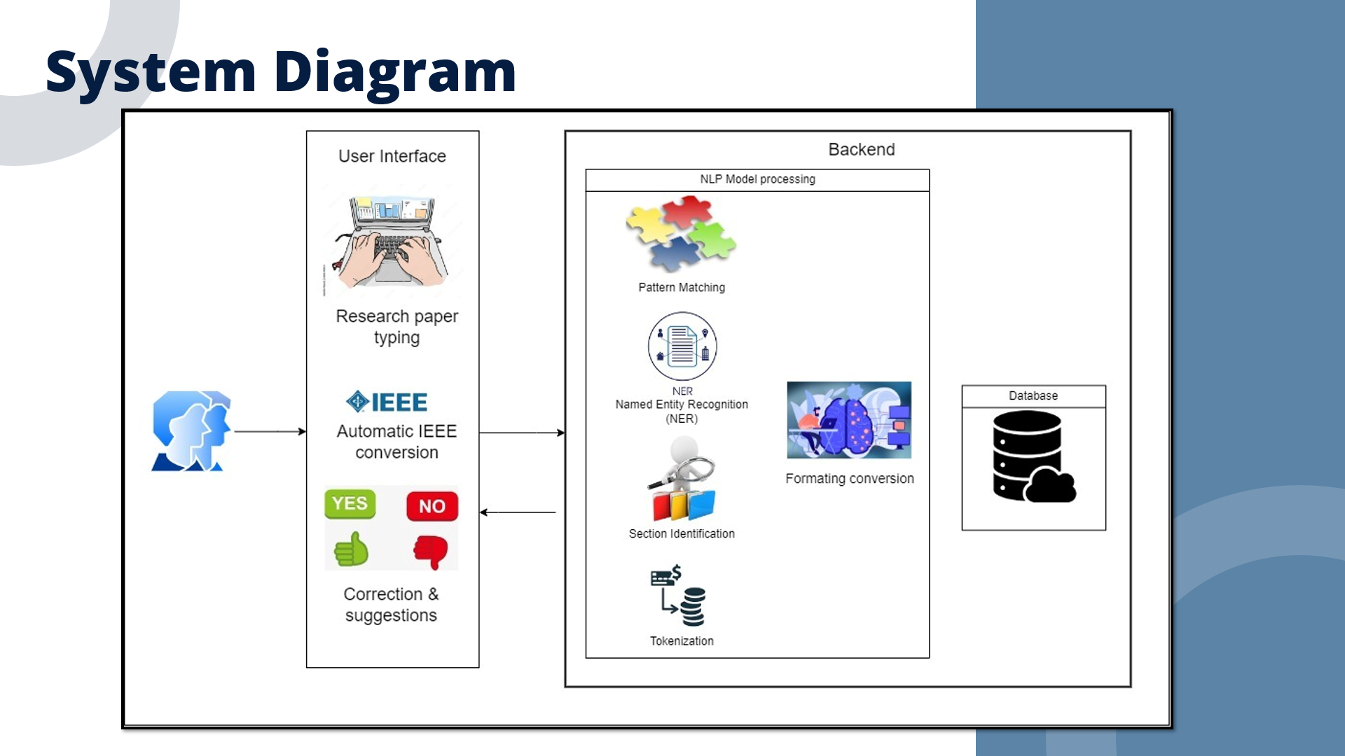
IT21375682 | Shandeep Jayapalan | 24-25J-146

Slide 39
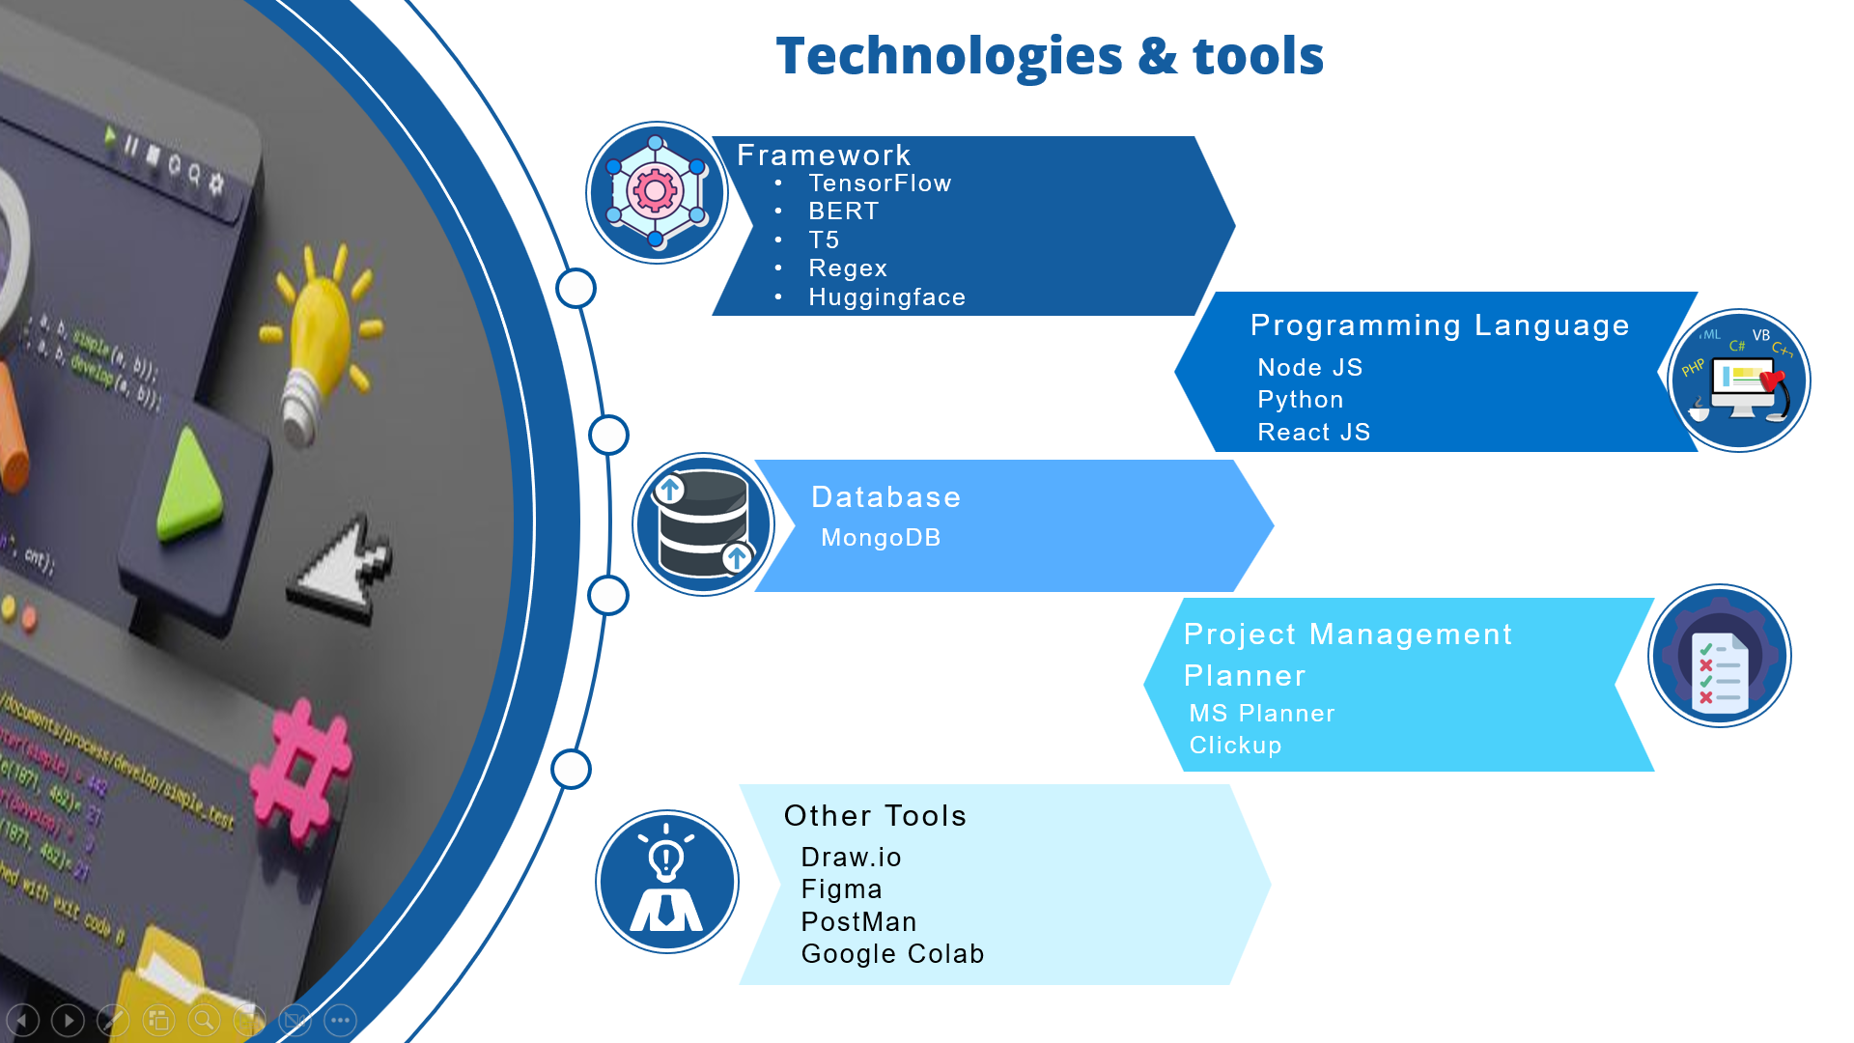
IT21375682 | Shandeep Jayapalan | 24-25J-146

Slide 40
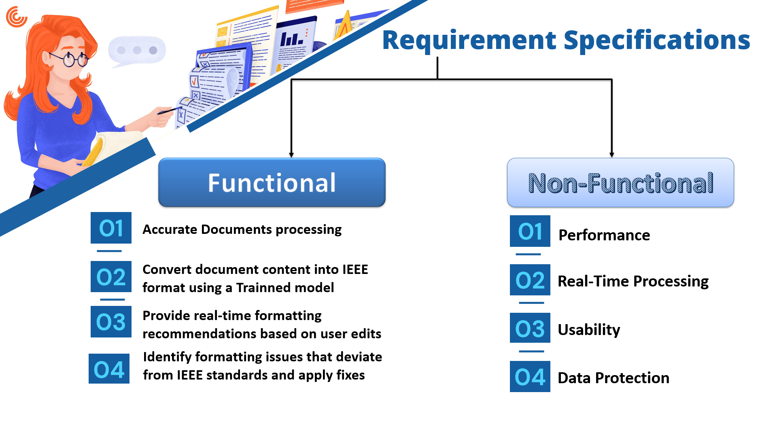
IT21375682 | Shandeep Jayapalan | 24-25J-146

Slide 41
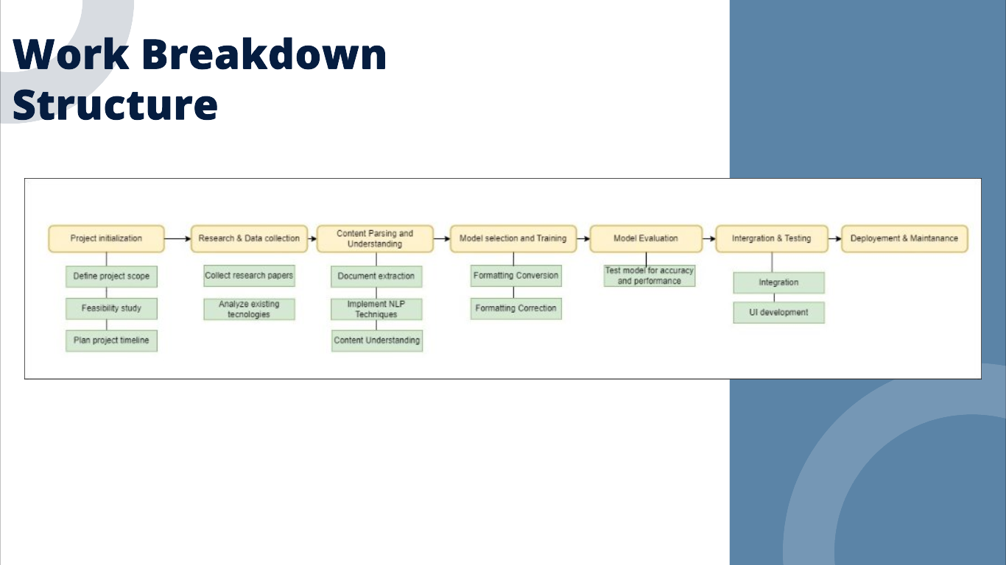
IT21375682 | Shandeep Jayapalan | 24-25J-146

Slide 42
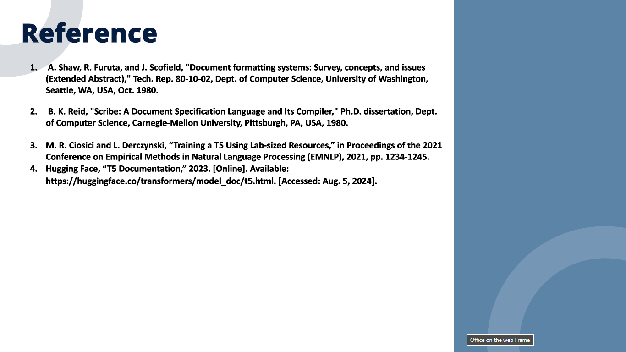
IT21375682 | Shandeep Jayapalan | 24-25J-146

Slide 43
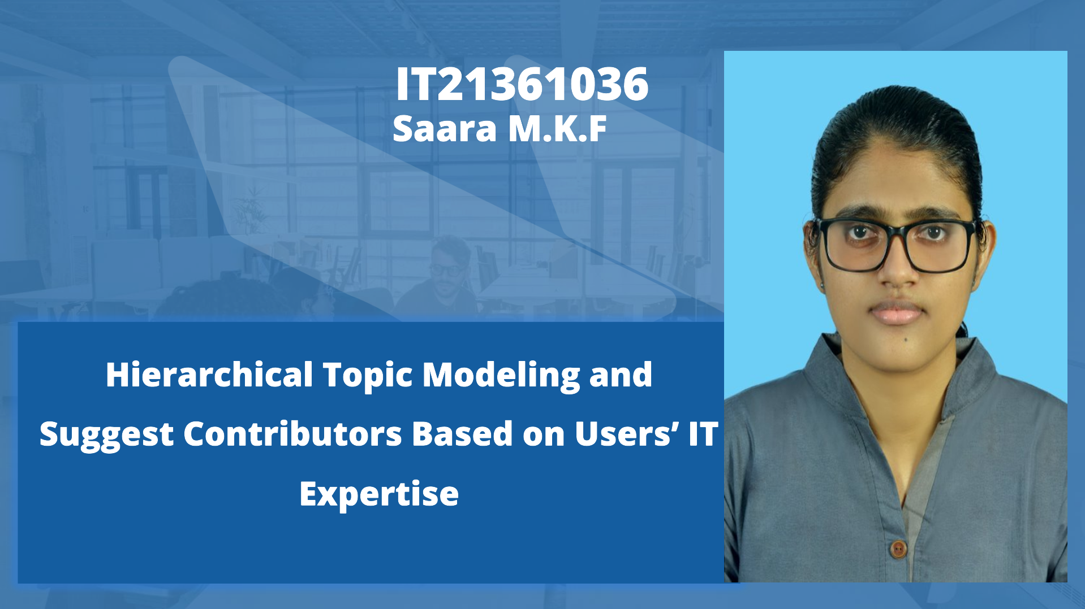
IT21361036 | Saara M.K.F | 24-25J-146

Slide 44
IT21361036 | Saara M.K.F | 24-25J-146

Slide 45
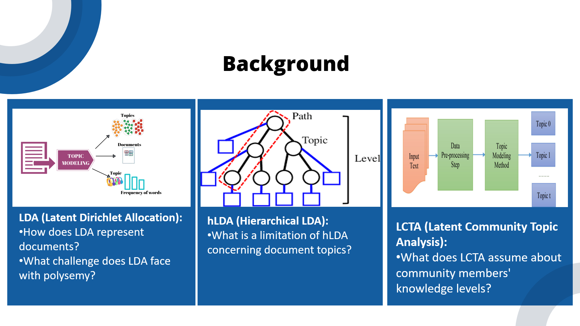
IT21361036 | Saara M.K.F | 24-25J-146

Slide 46
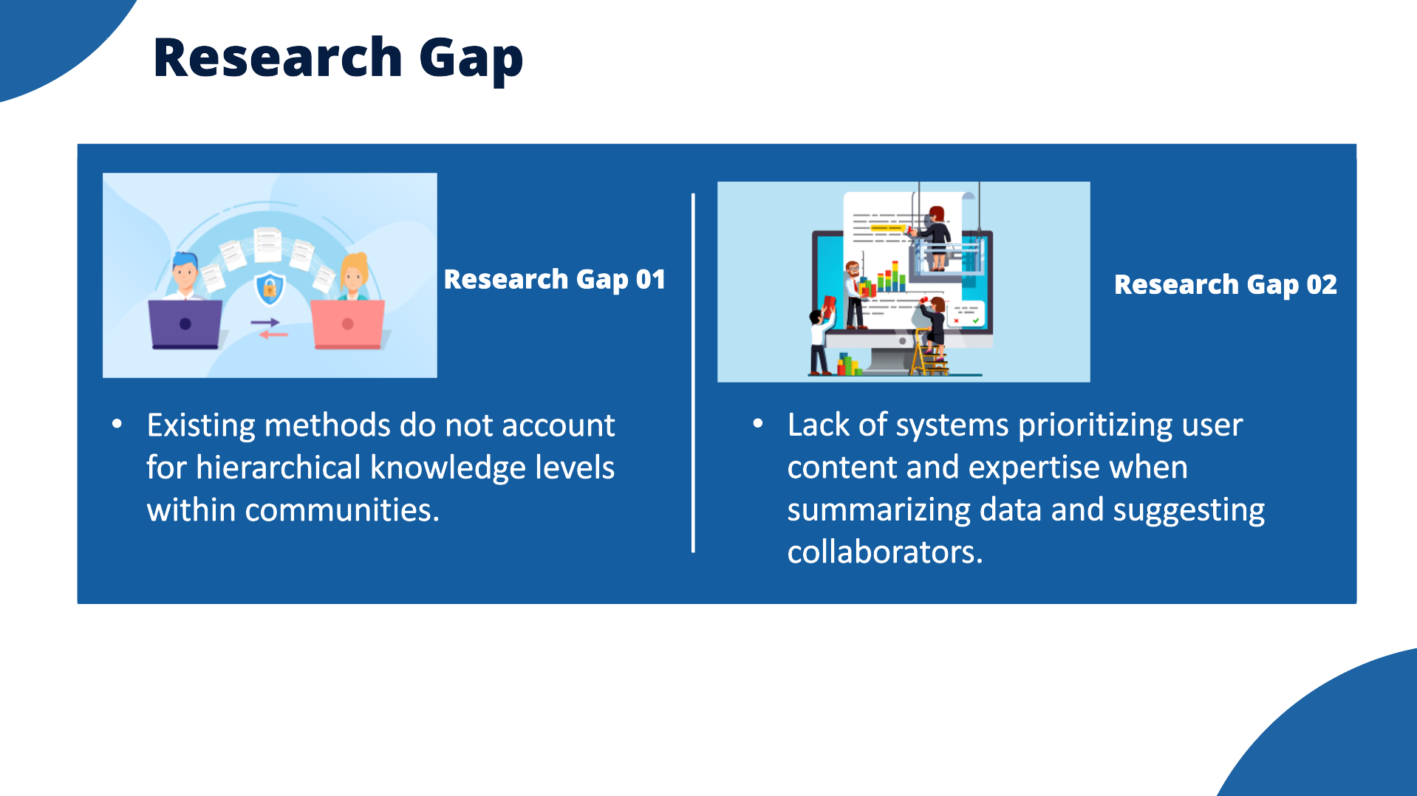
IT21361036 | Saara M.K.F | 24-25J-146

Slide 47
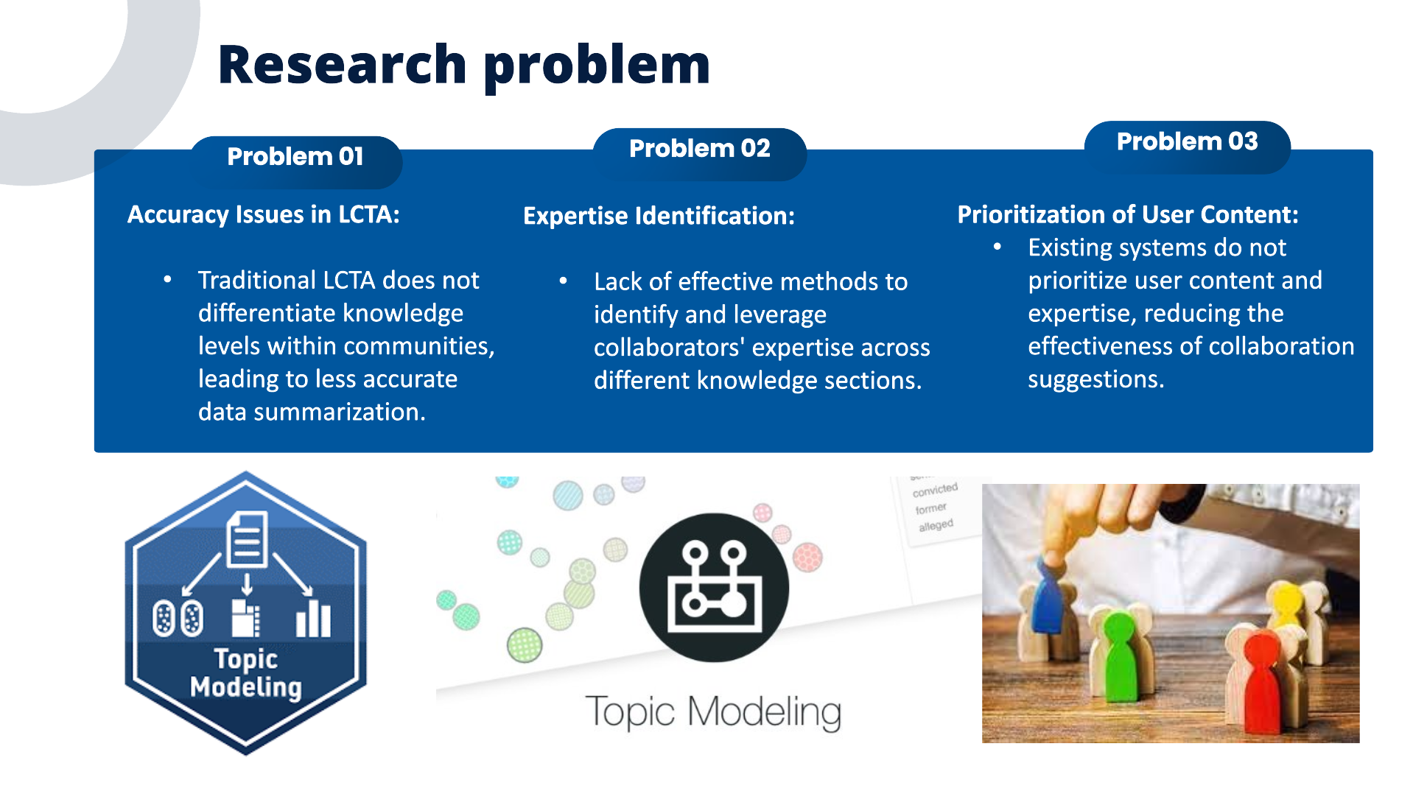
IT21361036 | Saara M.K.F | 24-25J-146

Slide 48
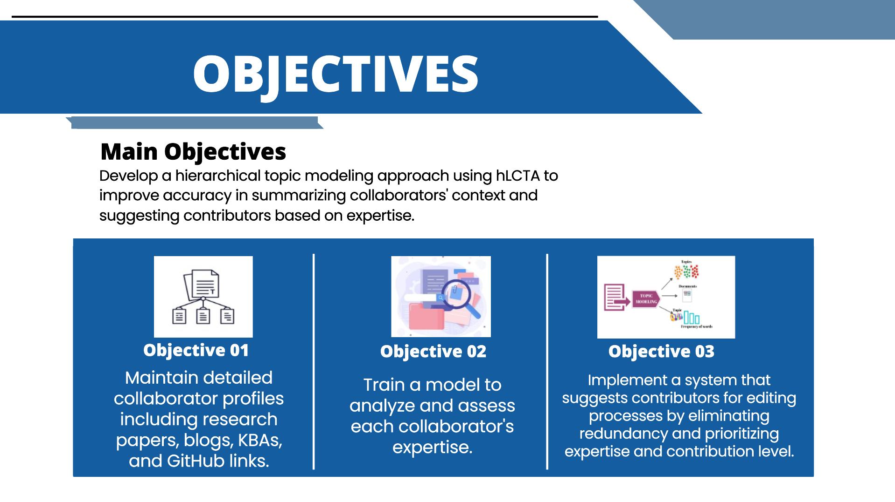
IT21361036 | Saara M.K.F | 24-25J-146

Slide 49
IT21361036 | Saara M.K.F | 24-25J-146

Slide 50
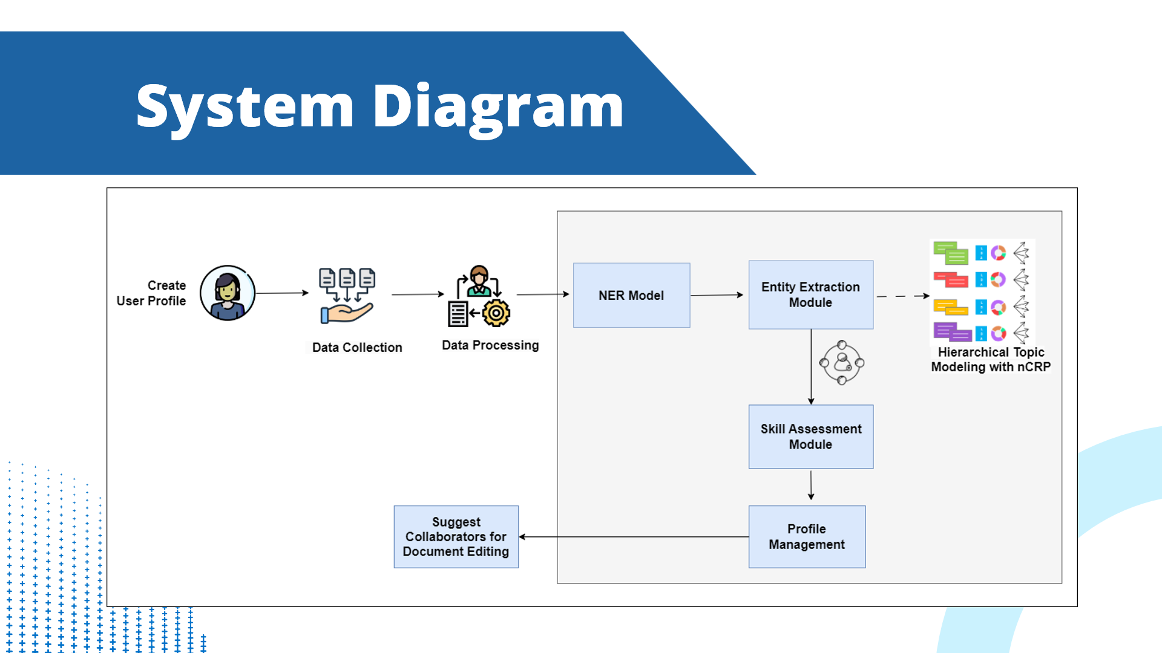
IT21361036 | Saara M.K.F | 24-25J-146

Slide 51
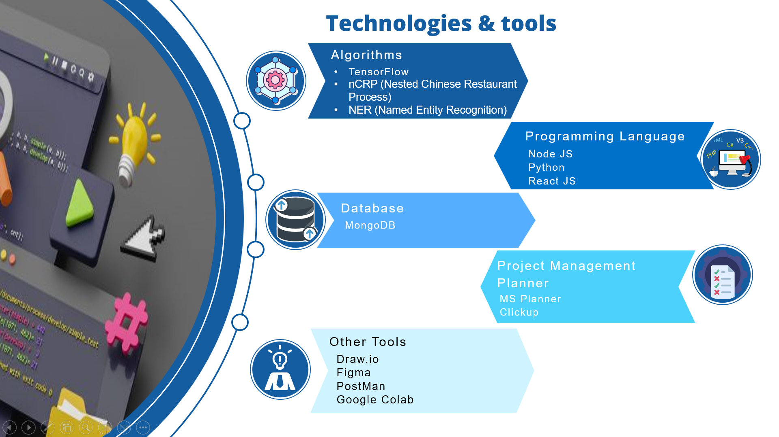
IT21361036 | Saara M.K.F | 24-25J-146

Slide 52
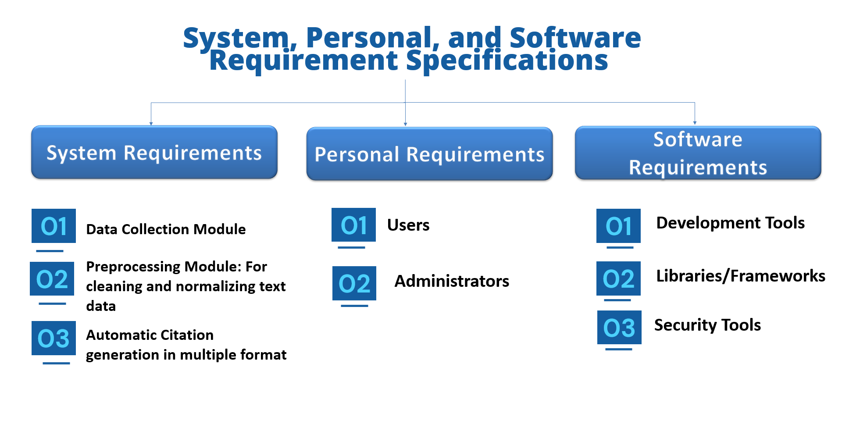
IT21361036 | Saara M.K.F | 24-25J-146

Slide 53
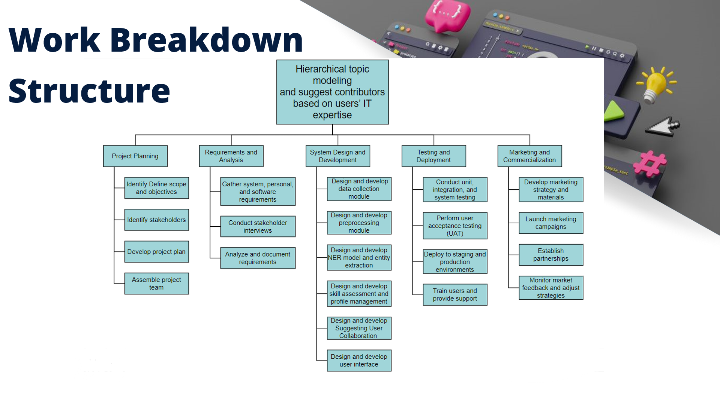
IT21361036 | Saara M.K.F | 24-25J-146

Slide 54
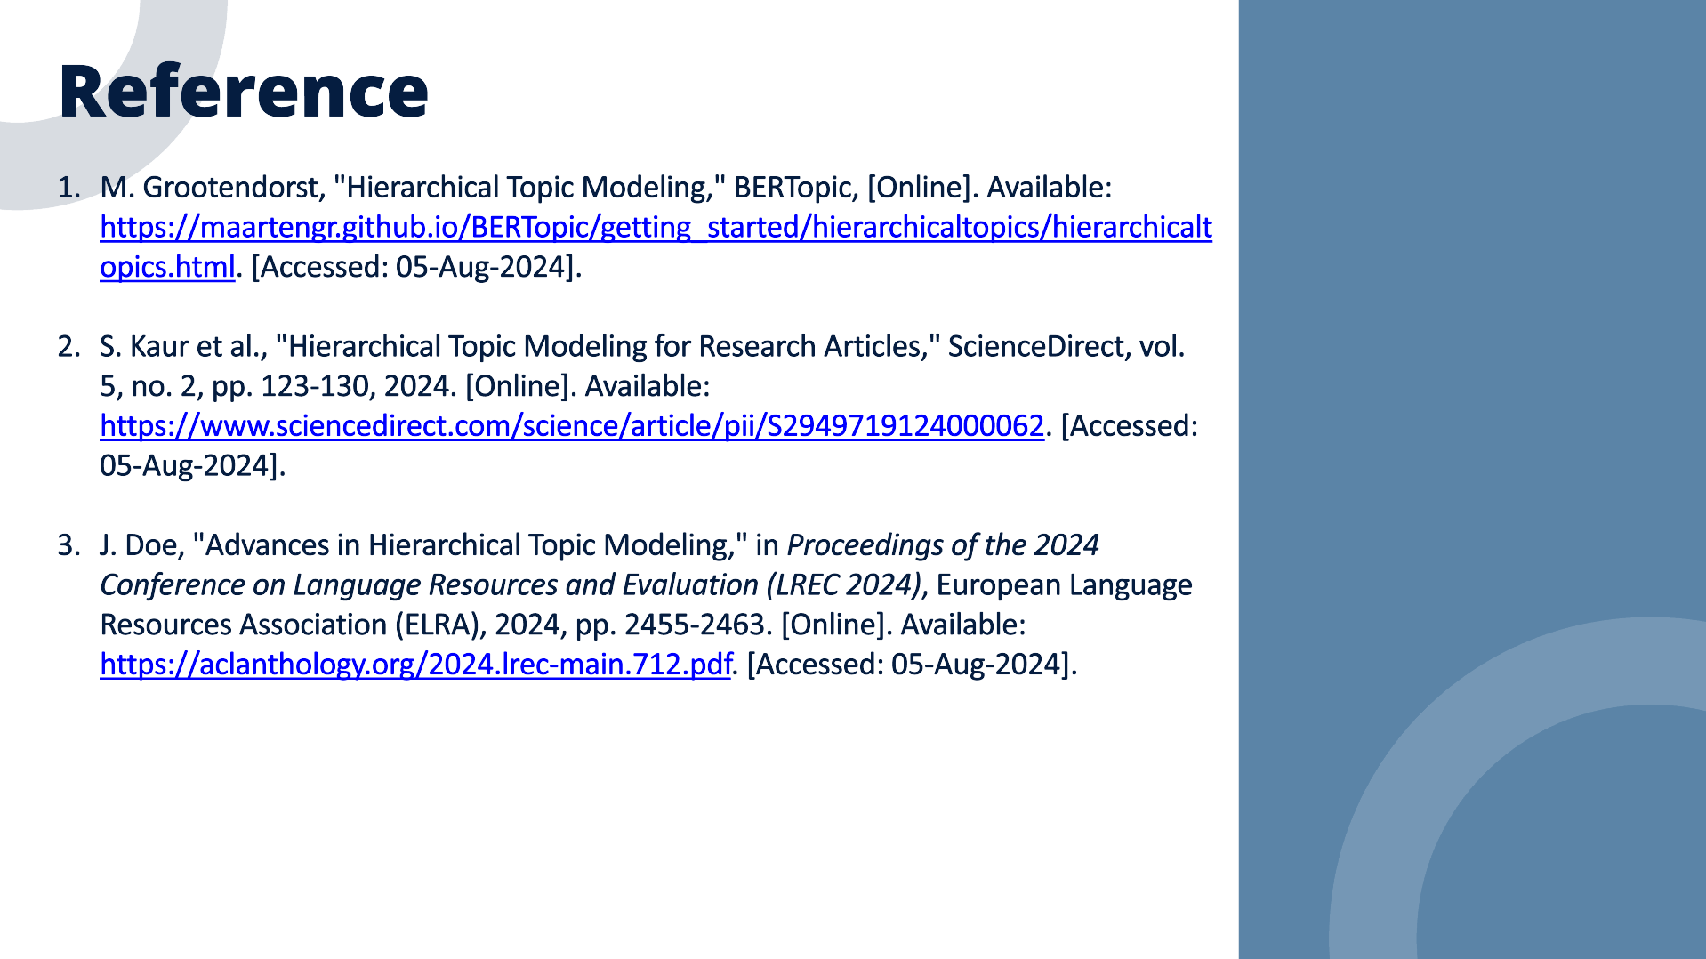
IT21361036 | Saara M.K.F | 24-25J-146

Slide 55
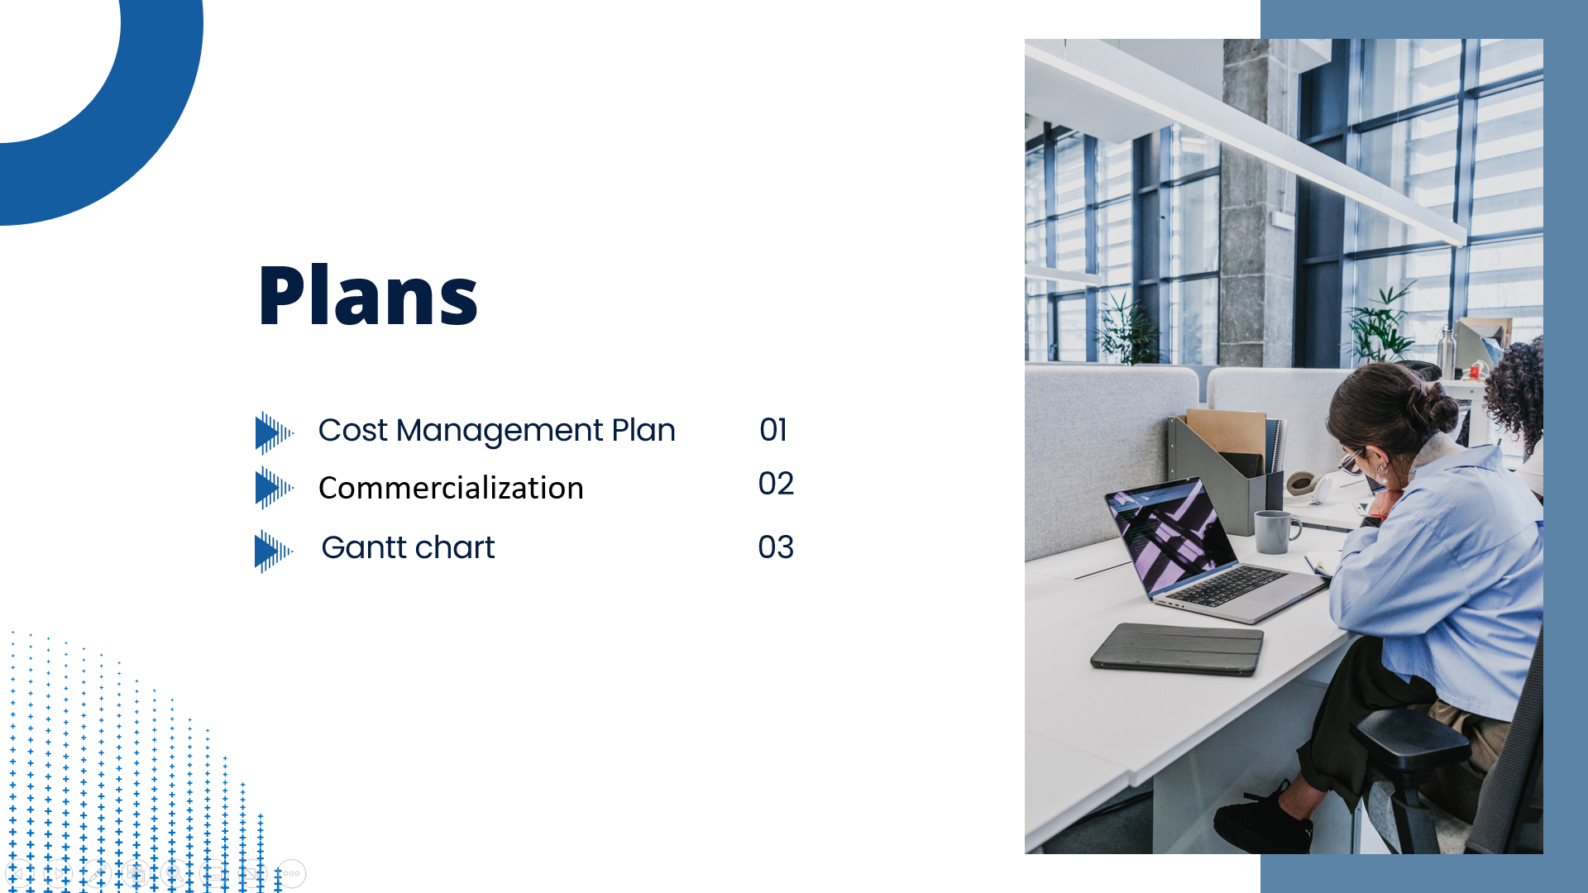

Slide 56
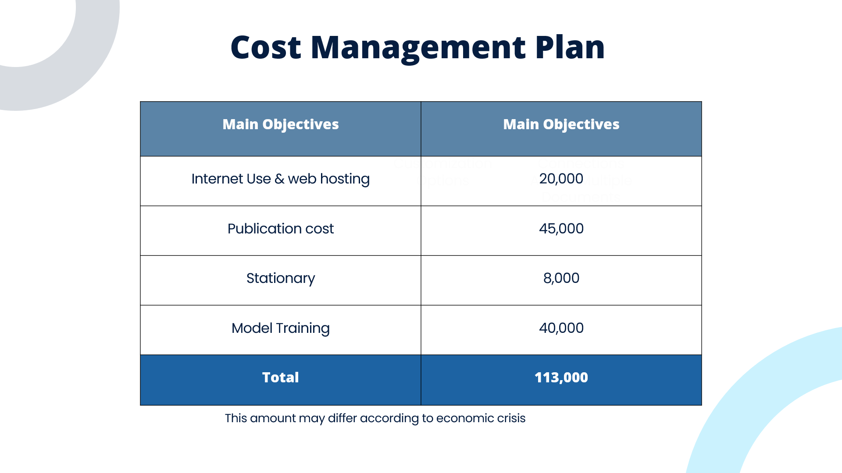

Slide 57


Slide 58


Slide 59


